Slide 1
Electricity Market
A paradigm change: Active integrated electricity systems with demand flexibility an active contributor
Dr. Venizelos Efthymiou
efthymiou.venizelos@ucy.ac.cy

Slide 2

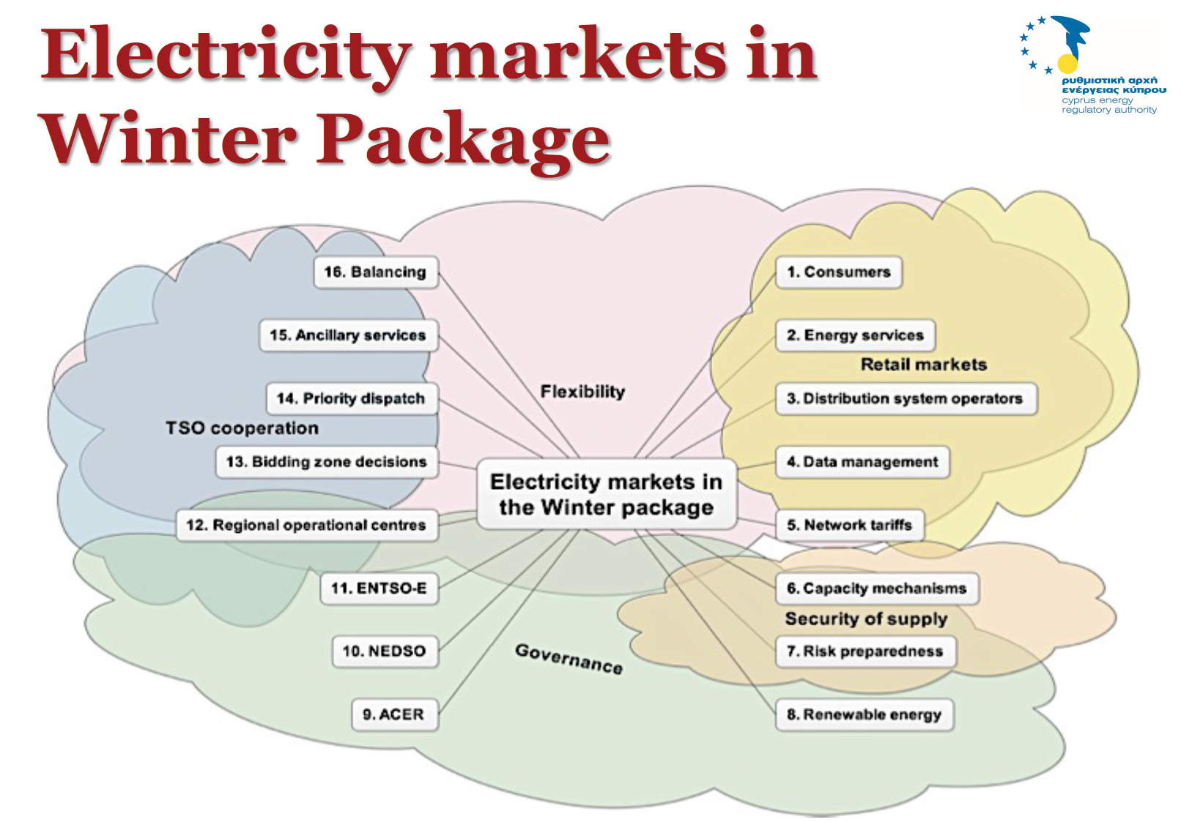

Slide 3
Gross pool vs Net Pool
Notes:
Why all this complexity that we have all read in the public consultation a few months back?
SMP = System Marginal Price

Slide 4
Wholesale buyer vs Bilateral Market
Notes:
How is this related to the future? The European strategy for a sustainable economy? The 10 priorities that have been identified as key to the European economy?

Slide 5
The Electricity market in Cyprus
Notes:
The Net Pool put forward by CERA as the right market model for Cyprus is undoubtedly the mature market for,
Countries or regions that offer a healthy environment (more than 5 strong providers of energy) for competition in electrical energy trade,
Adequately interconnected grid that does not limit the free flow of energy where needed (at least 15% of interconnected capacity with neighbouring markets)
We know very well that such favourable situation is not prevailing in Cyprus and it will never be. Interconnection with third countries can only happen under a sub-sea connection and this is going to be of the level of 15% of local capacity since anything more than that is jeopardising the security of supply of the country. From investment point of you such an investment is dimmed to failure. Why then the net pool model is considered as the best option for Cyprus?

Slide 6
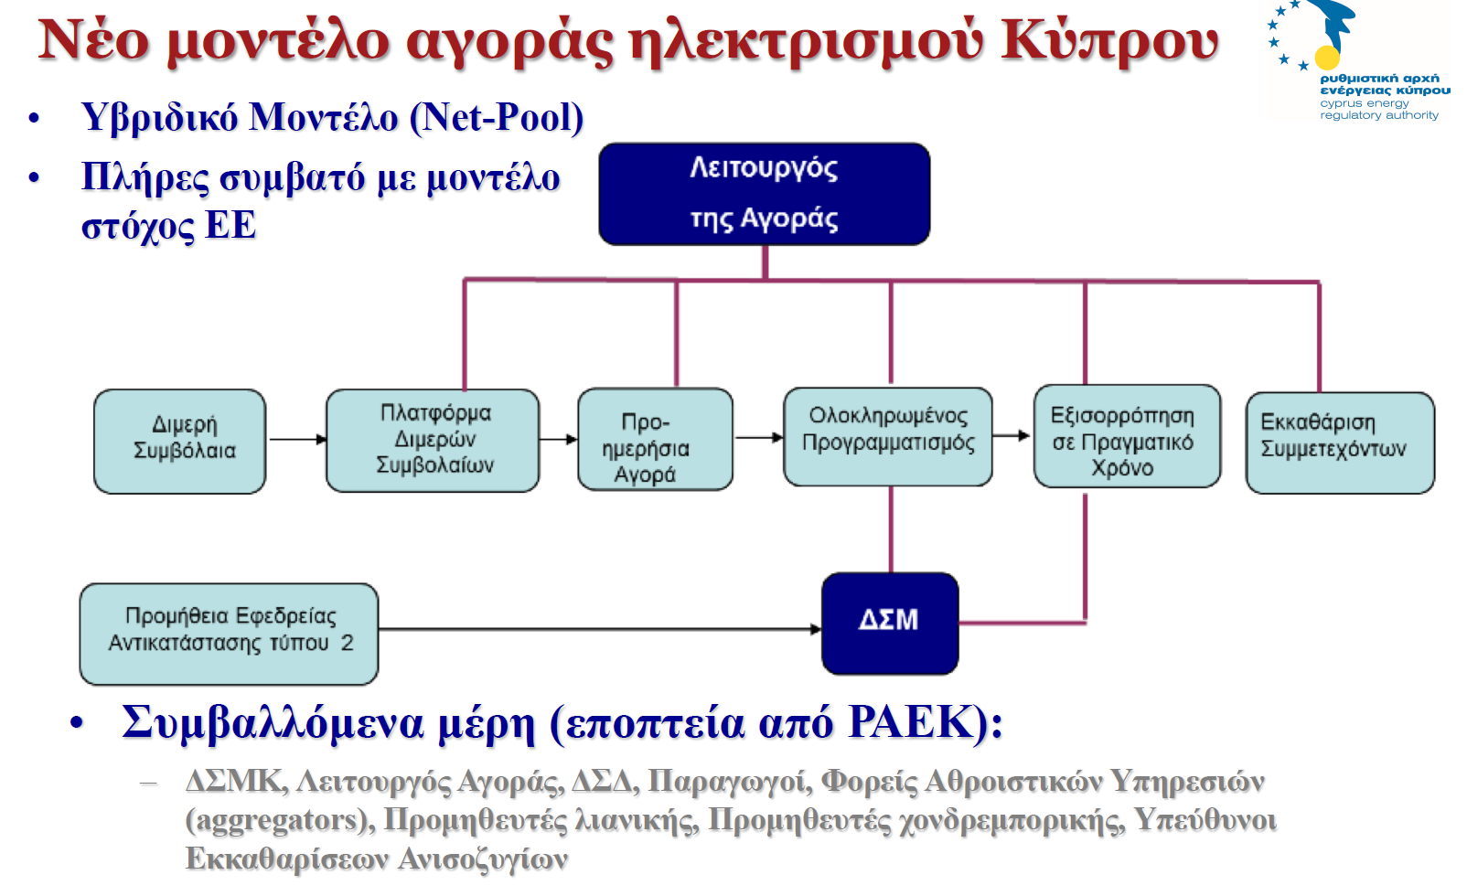

Slide 7
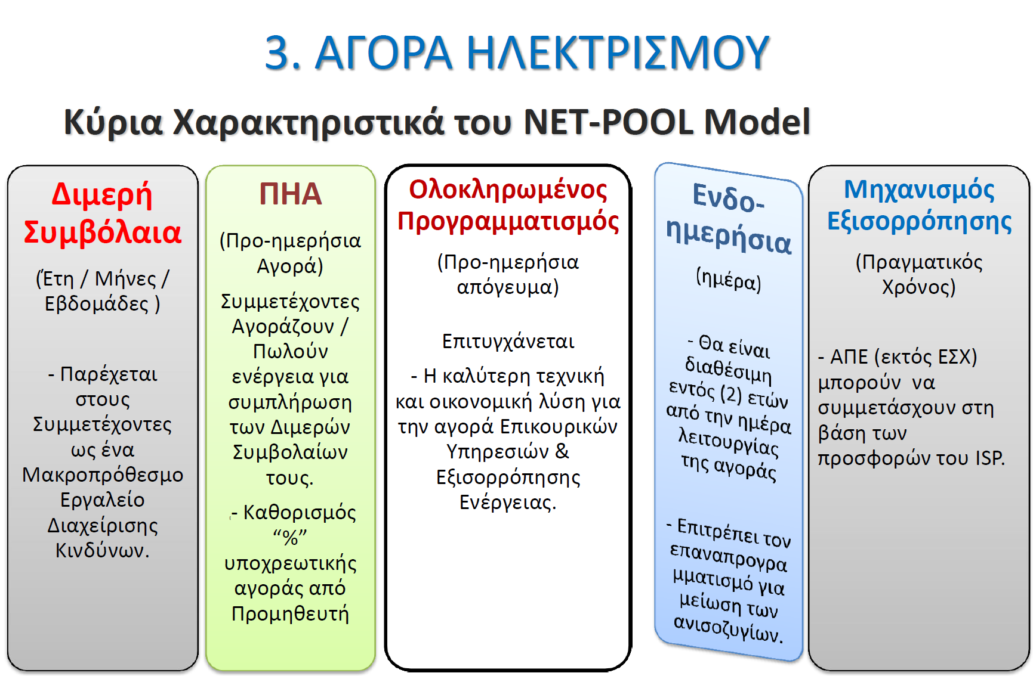

Slide 8
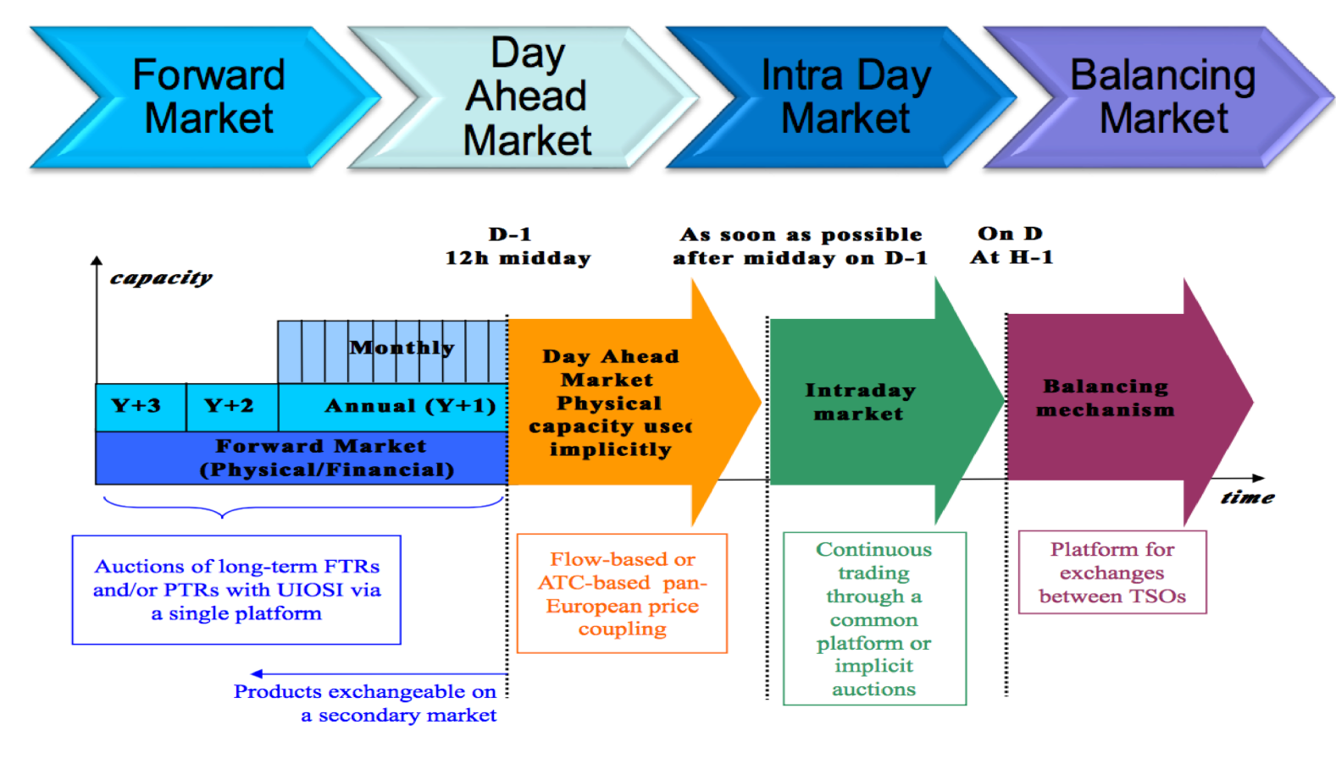
EU electricity market target model

Slide 9
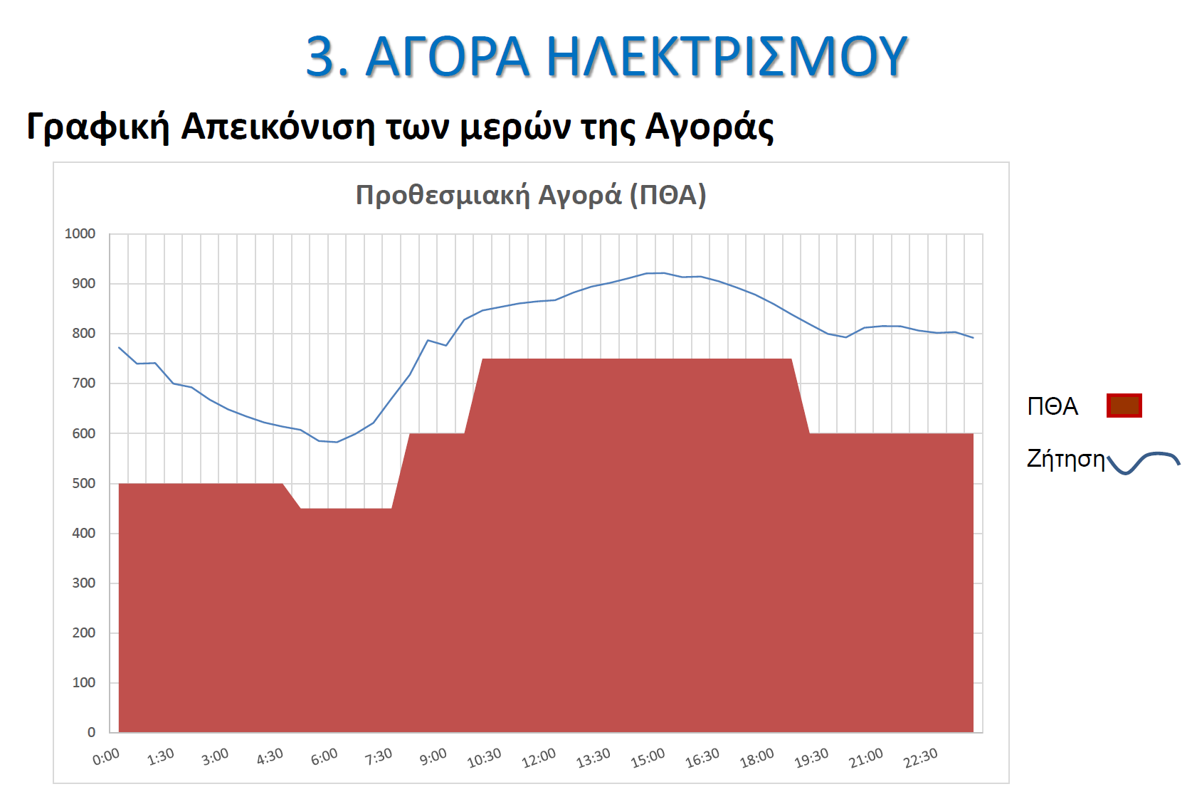

Slide 10
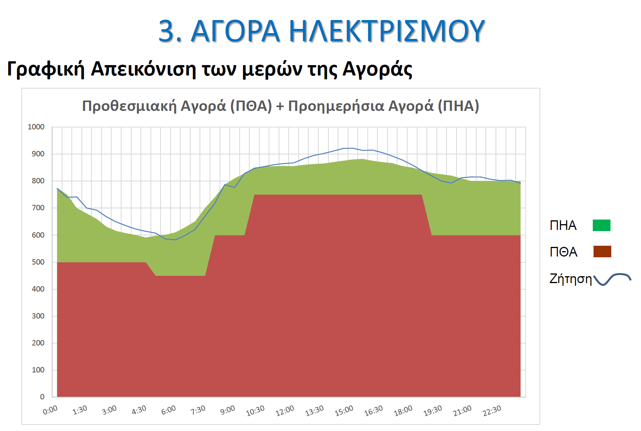

Slide 11
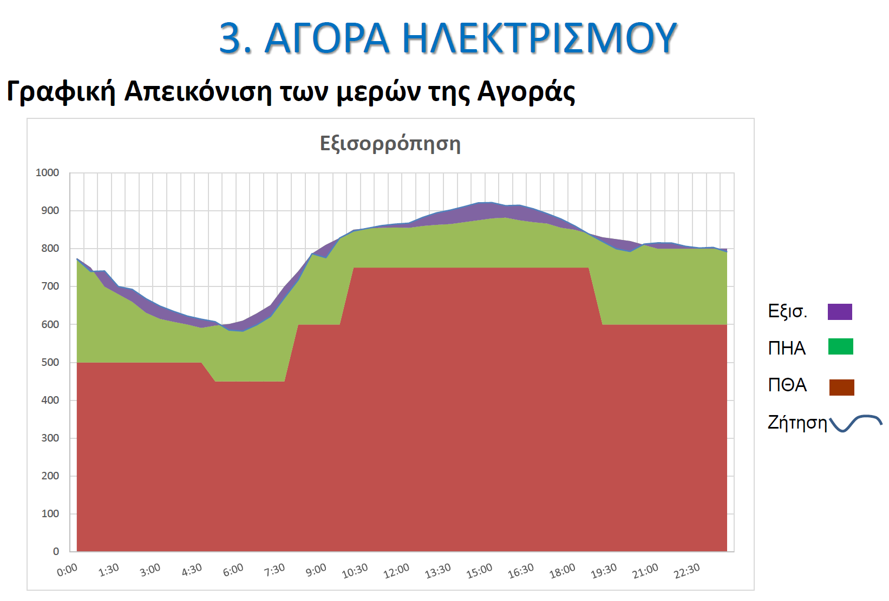

Slide 12
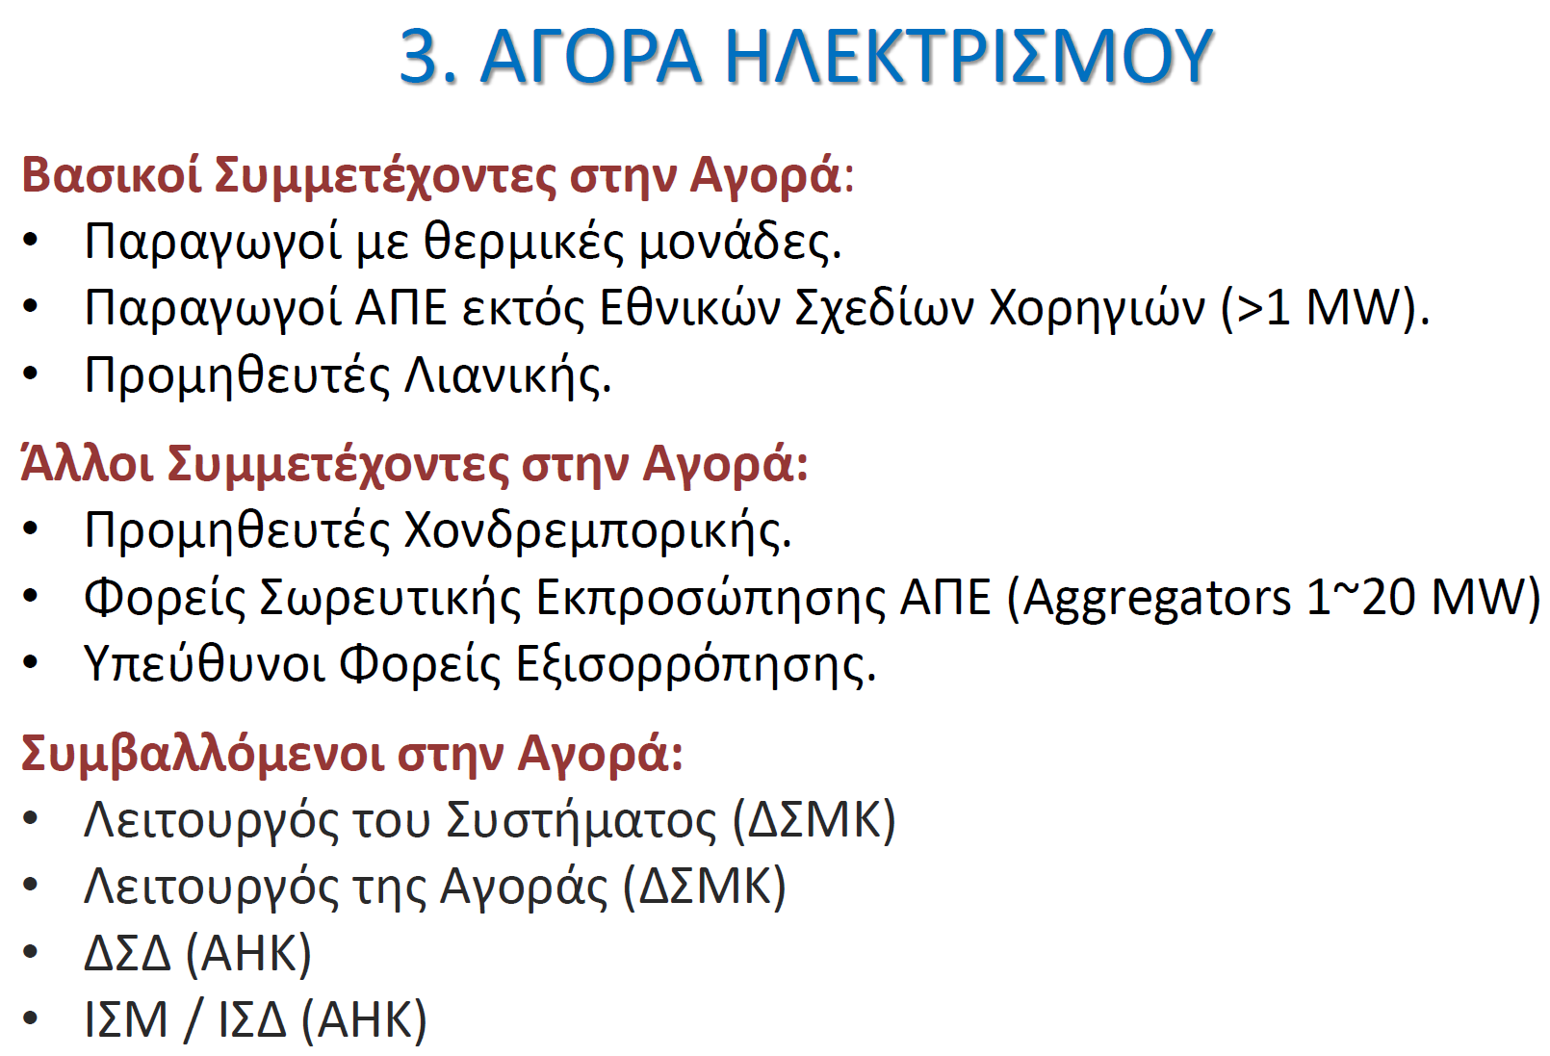

Slide 13
Business is not as usual: A new norm is born
Through the dynamics of RES we are re-shaping the electrical industry,
We need to go beyond integration – RES is not as conceived, a tolerable integration into status quo arrangements but a much smarter need,
Through the adoption of these new technologies, a new norm is born that requires:

Slide 14
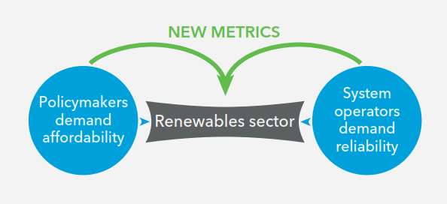
Convergence between policymakers for better prices and demand reliability from System Operators

Slide 15
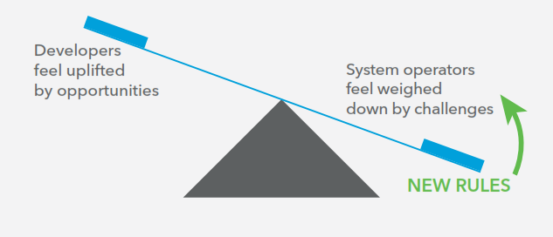
Rebalancing between opportunities of developers and grid challenges of System Operators

Slide 16
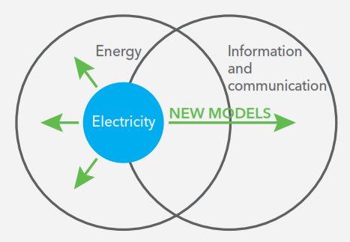
New market models for expanding the electricity business into the internet of energy

Slide 17
Smart Grid Task Force EG3: Options of handling Smart Grids Data
Notes:
SMART GRID TASK FORCE
EG3 REPORT in January 2013
Options on handling Smart Grids Data

Slide 18
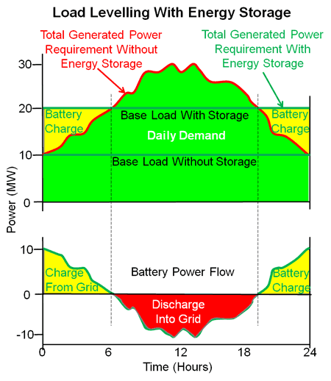
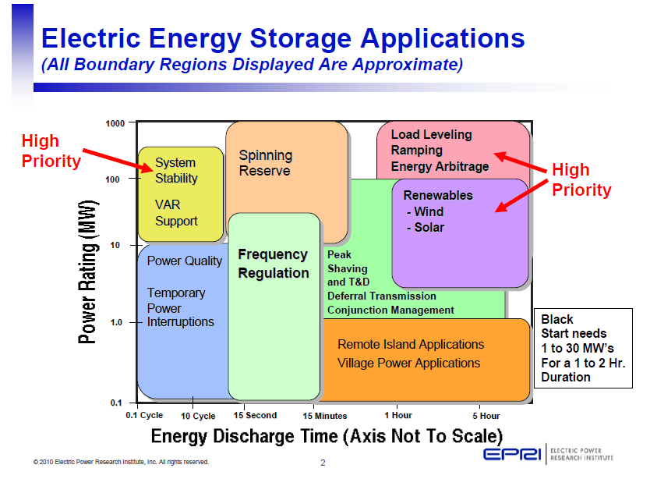
The bi-directional nature of storage offers a wealth of flexibility …
Complex to regulate due to its multi-use capability – But offers much needed flexibility !
Notes:
The emerging technologies require storage to replace inertia, transform intermittency to dispatchable energy source and decouple generation from demand.
Energy storage applications and benefits: These may be combined into attractive value propositions.
Electric supply
1. Electric energy time-shift
2. Electric supply capacity
Ancillary services
3. Load following
4. Area regulation
5. Electric supply reserve capacity
6. Voltage support
Grid system enhancements
7. Transmission support
8. Transmission congestion relief
9. Transmission & distribution (T&D)
Upgrade deferral
10. Substation on-site power
End user/utility customer benefits
11. Time-of-use (TOU) energy cost
Management
12. Demand charge management
13. Electric service reliability
14. Electric service power quality
Renewables integration
15. Renewables energy time-shift
16. Renewables capacity firming
17. Renewables integration

Slide 19
Notes:
The smartness of distributed resources capable of optimally responding to system needs, hence taking care of the first line of response for quality of supply is a must, including possibilities of island mode operation. These technologies are with us and practised in many regions of the world. The current version of the market rules is not facilitating such operations.
With the new technology mix we can decouple generation from demand, increasing both grid flexibility and performance. The paradigm change that we are seeing today is the change from “generation following demand” to “demand following generation availability”. For this to happen and be in a position to exploit all hidden benefits the market and grid rules should embrace the evolving technologies and their related capabilities.

Slide 20
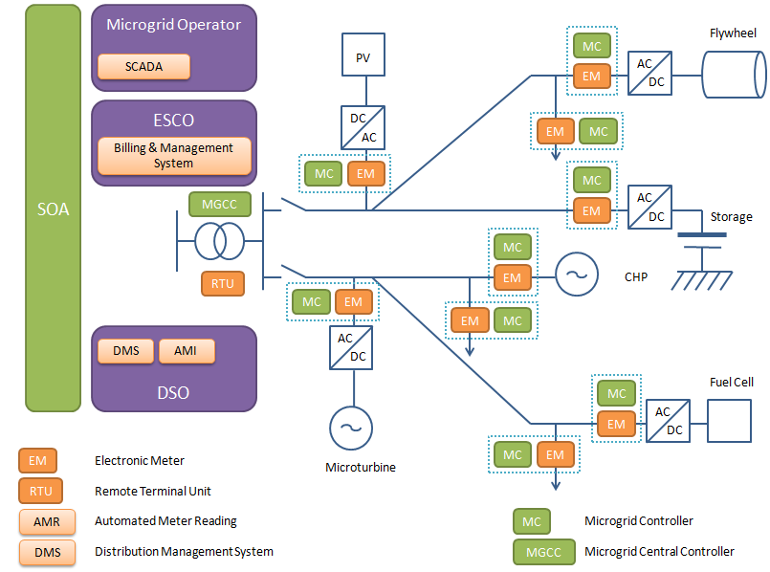
Need for smart incentivized Regulation …
Distributed control architecture will prevail seamlessly linking all active elements of the integrated grid
Embedded systems with microgrid capabilities or “web of cell” connectivity will offer quality inclusion of energy efficient buildings
Policy and Regulatory shortcomings need to be addressed for smart investments to prevail and maximize benefits to all active stakeholders !!!

Slide 21
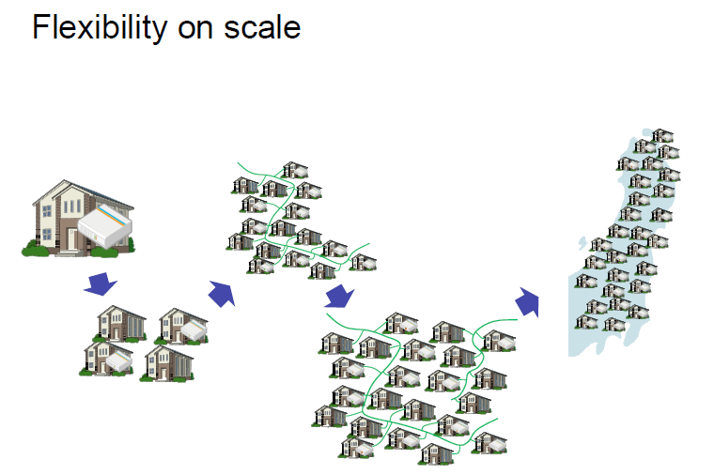
Scaling up is flexible ...
Notes:
Distributed resources are with us and growing. Price of electricity is the governing motive for such investments. However, they can offer much more than what is currently allowed in grid and market rules.

Slide 22
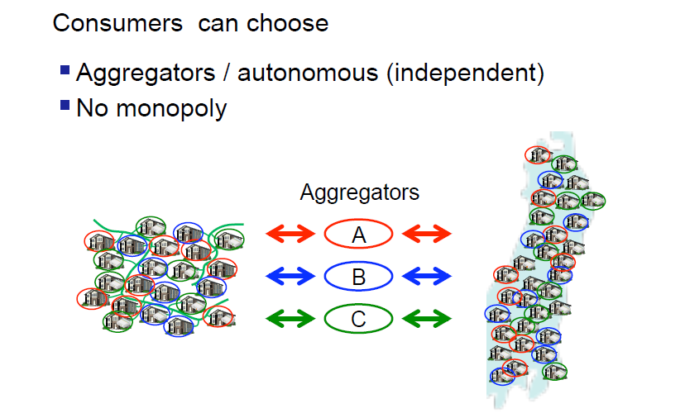
Aggregation is flexible ...

Slide 23
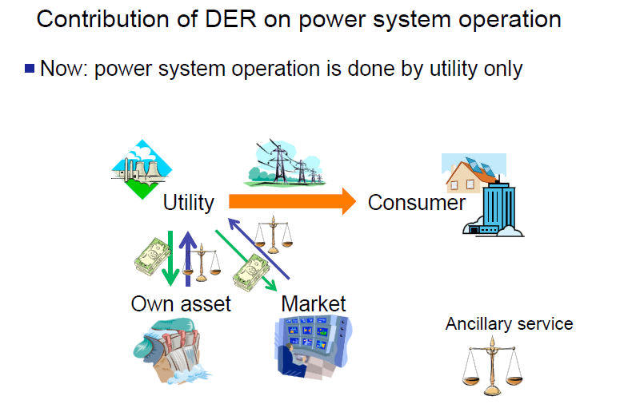
Market functioning is flexible ...

Slide 24
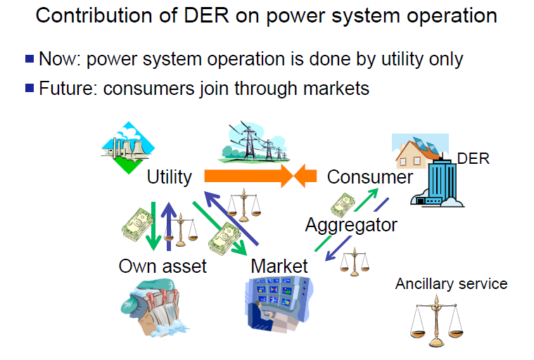
Market functioning through aggregators
Notes:
Market rules can be flexible, simple and robust but above all forward looking. Current version is an extension of business as usual that has served well the past years but not in line with the new norm that is emerging. The relatively small island of Cyprus should have market rules that are capacity driven and technology driven not energy driven, with a well balanced portfolio of ancillary services secured by both grid operators as market facilitators: TSO and DSO. We need to rethink decisions made for the benefit of the end user and the economy.

Slide 25
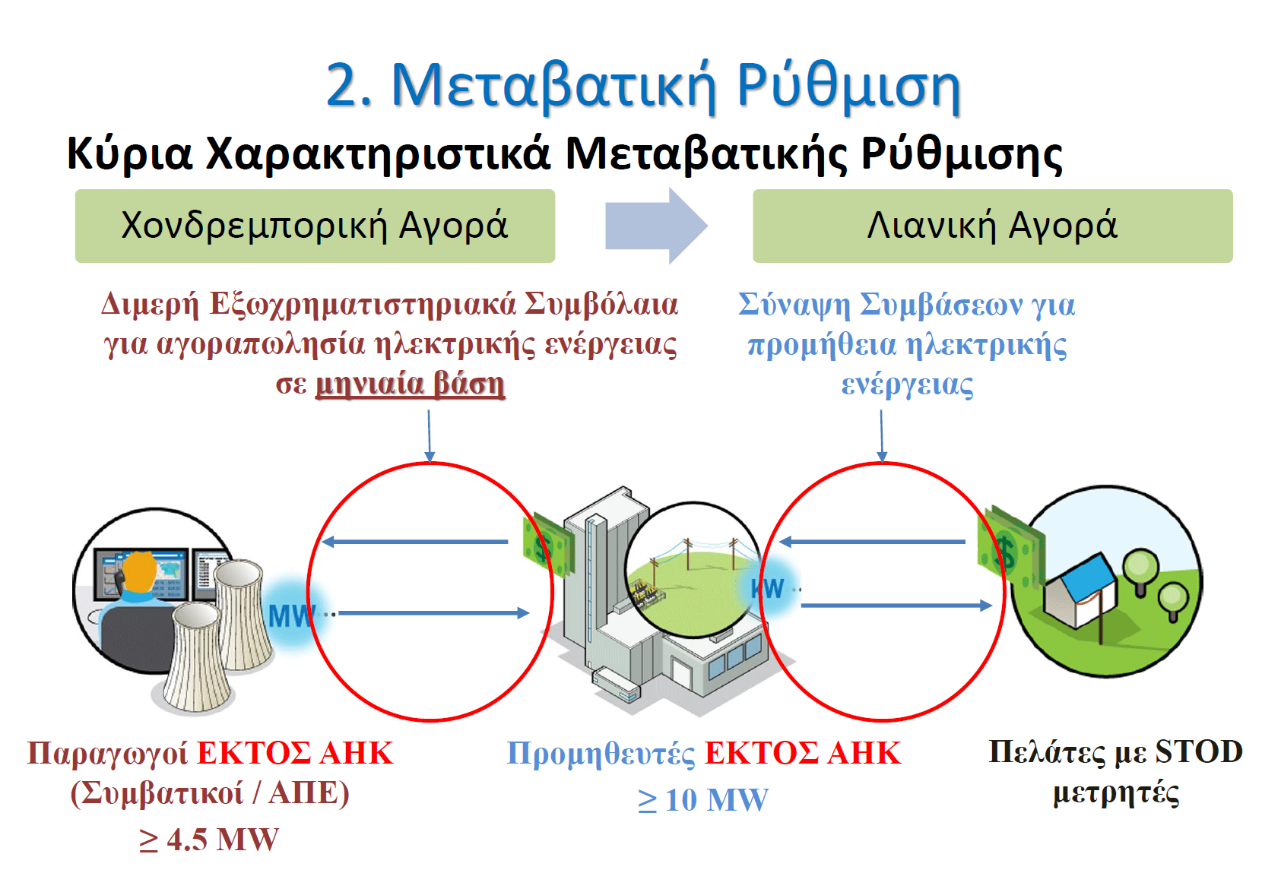

Slide 26
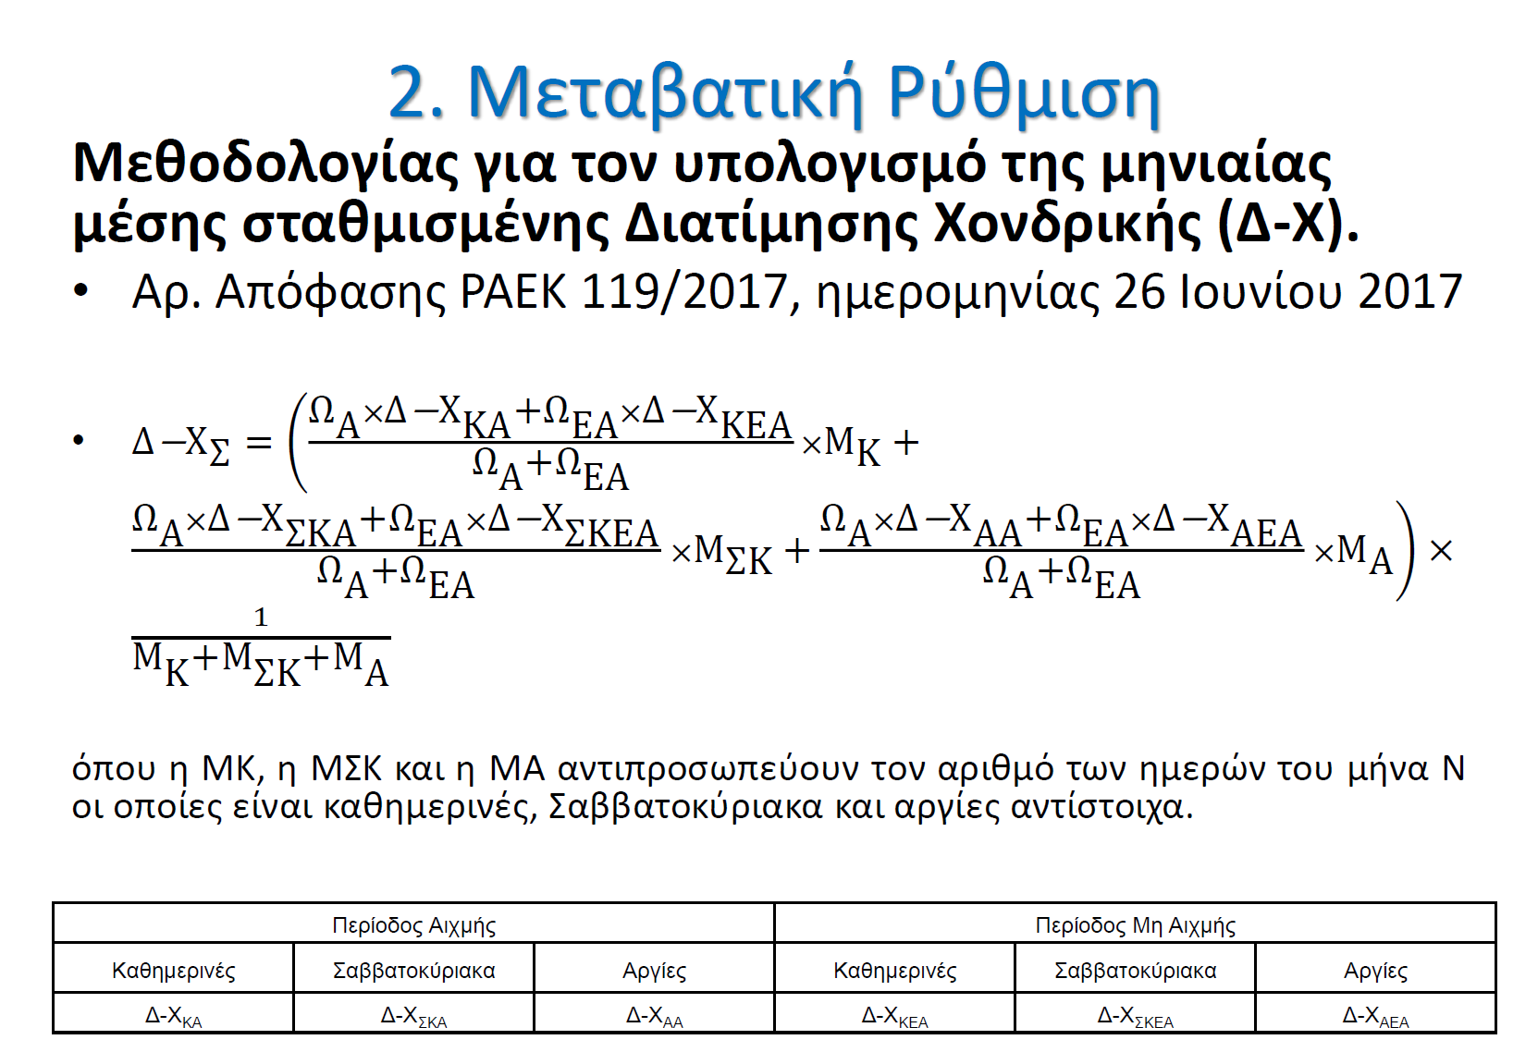

Slide 27
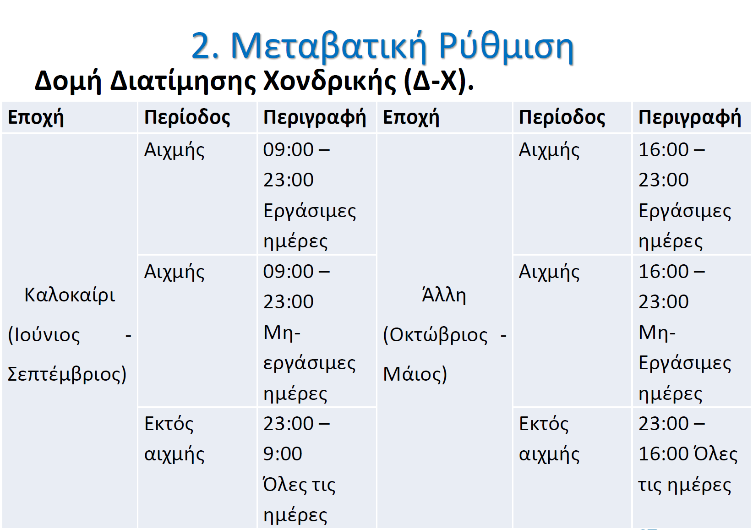

Slide 28
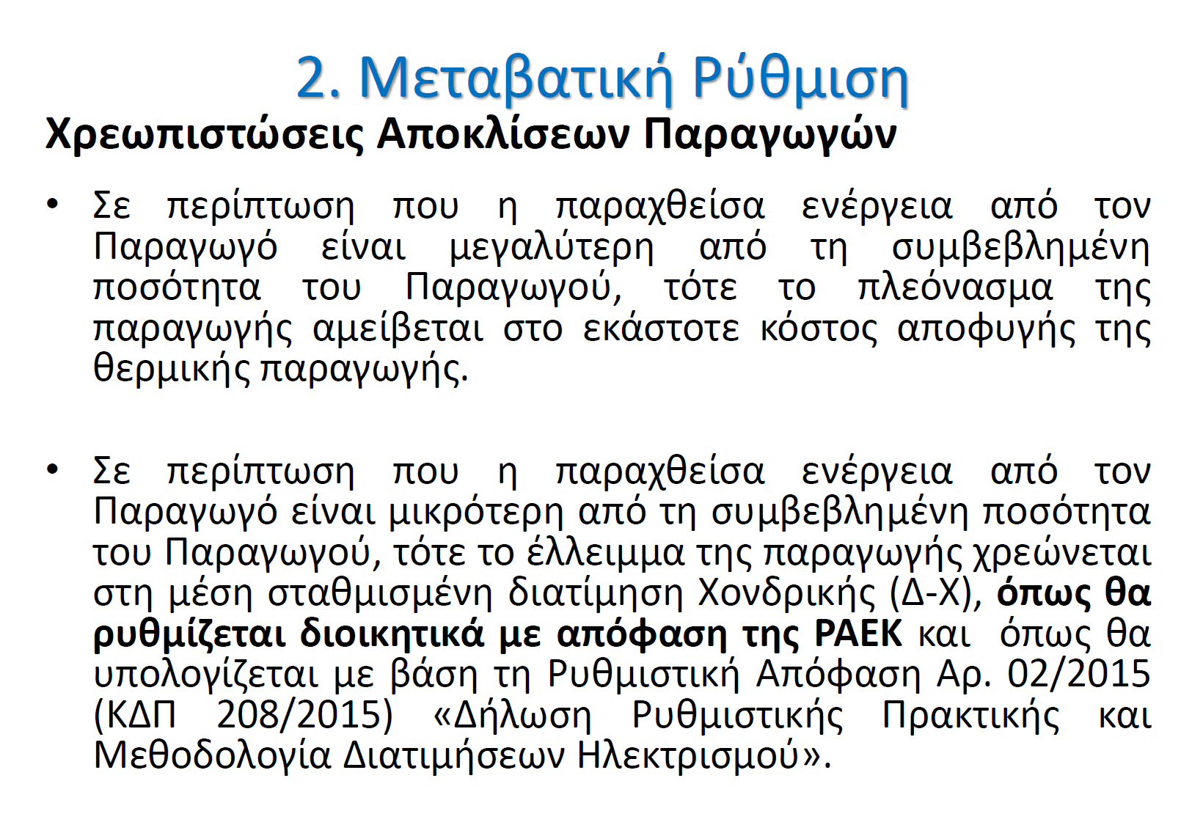

Slide 29
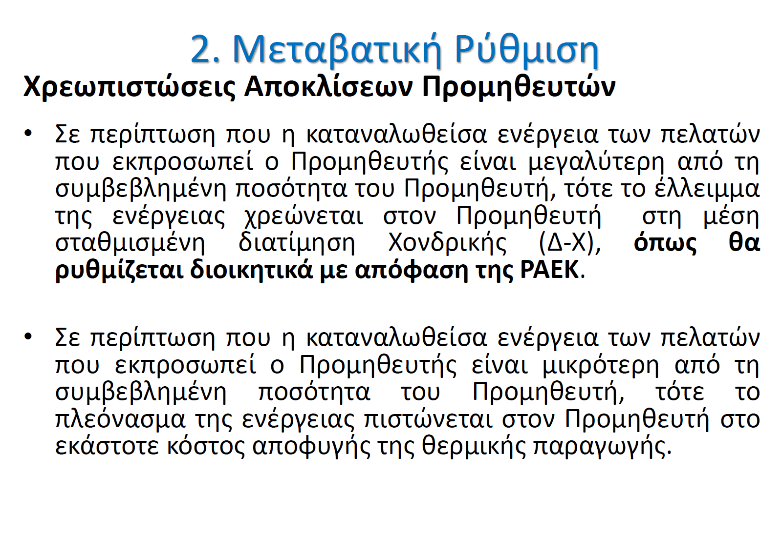

Slide 30


Website
Website www.foss.ucy.ac.cy
30

