Slide 1
CYPRUS BAR ASSOCIATION
SUBSIDY PROJECT FOR TRAINEE ADVOCATES

Slide 2
GUIDE TO THE ONLINE SYSTEM OF THE SUBSIDY PROJECT FOR TRAINEE ADVOCATES
The entire contents of this document belong exclusively to the CBA and copying, reproduction, transfer, storage, re-publication, processing, transmission, sale, distribution, publication, execution, downloading, translation, modification in any manner, announcement, dissemination or any other use of the contents of this presentation, in any manner or by any means, for commercial or other purposes, in part or in summary form, without the CBA’s prior express written consent, is expressly prohibited.

Slide 3
ANNOUNCEMENT
The CBA has upgraded the online system of the Trainee Subsidy Department, effective Monday 10 October 2022.
The Department now manages two Programming Periods (P.P.) in relation to the Trainee Subsidy.
Trainees who started their training up until 31 December 2022 come under the 2014-2020(2017-2023) P.P.
Trainees who started their training on or after 01/01/2023 come under the THALIA (2021-2027) P.P.
• The Call for the SUBSIDY PROJECT FOR YOUNG LAW GRADUATES 2014-2020 (2017-2023) P.P.:
https://www.cyprusbarassociation.org/index.php/el/for-trainees/subsidy-project-for-trainee-advocates-2017-2021
The Call for the SUBSIDY PROJECT FOR YOUNG LAW GRADUATES THALIA 2021 -2027 :
https://www.cyprusbarassociation.org/index.php/el/for-trainees/thaleia-subsidy-project-for-opportunities-to-new-law-graduates-2021-2027
Here follows a Guidance Manual on the correct completion and submission of the applications, as well as instructions on the subsequent procedures relating to the submission of relevant files/forms for the payment of the allowance.
NOTE.1 : Trainees who have already submitted an application in person and/or are awaiting a reply and/or have already obtained the approval of the CBA should:
Proceed to LOG IN
Select "forgot password".
They do not need to create an account, as their account has already been created by the CBA.
They should not select CREATE AN ACCOUNT or SUBMIT AN APPLICATION.
NOTE.2 : ALL THE INFORMATION MUST BE COMPLETED USING GREEK CHARACTERS ONLY (APPLICATION – CHANGES, etc.).

Slide 4
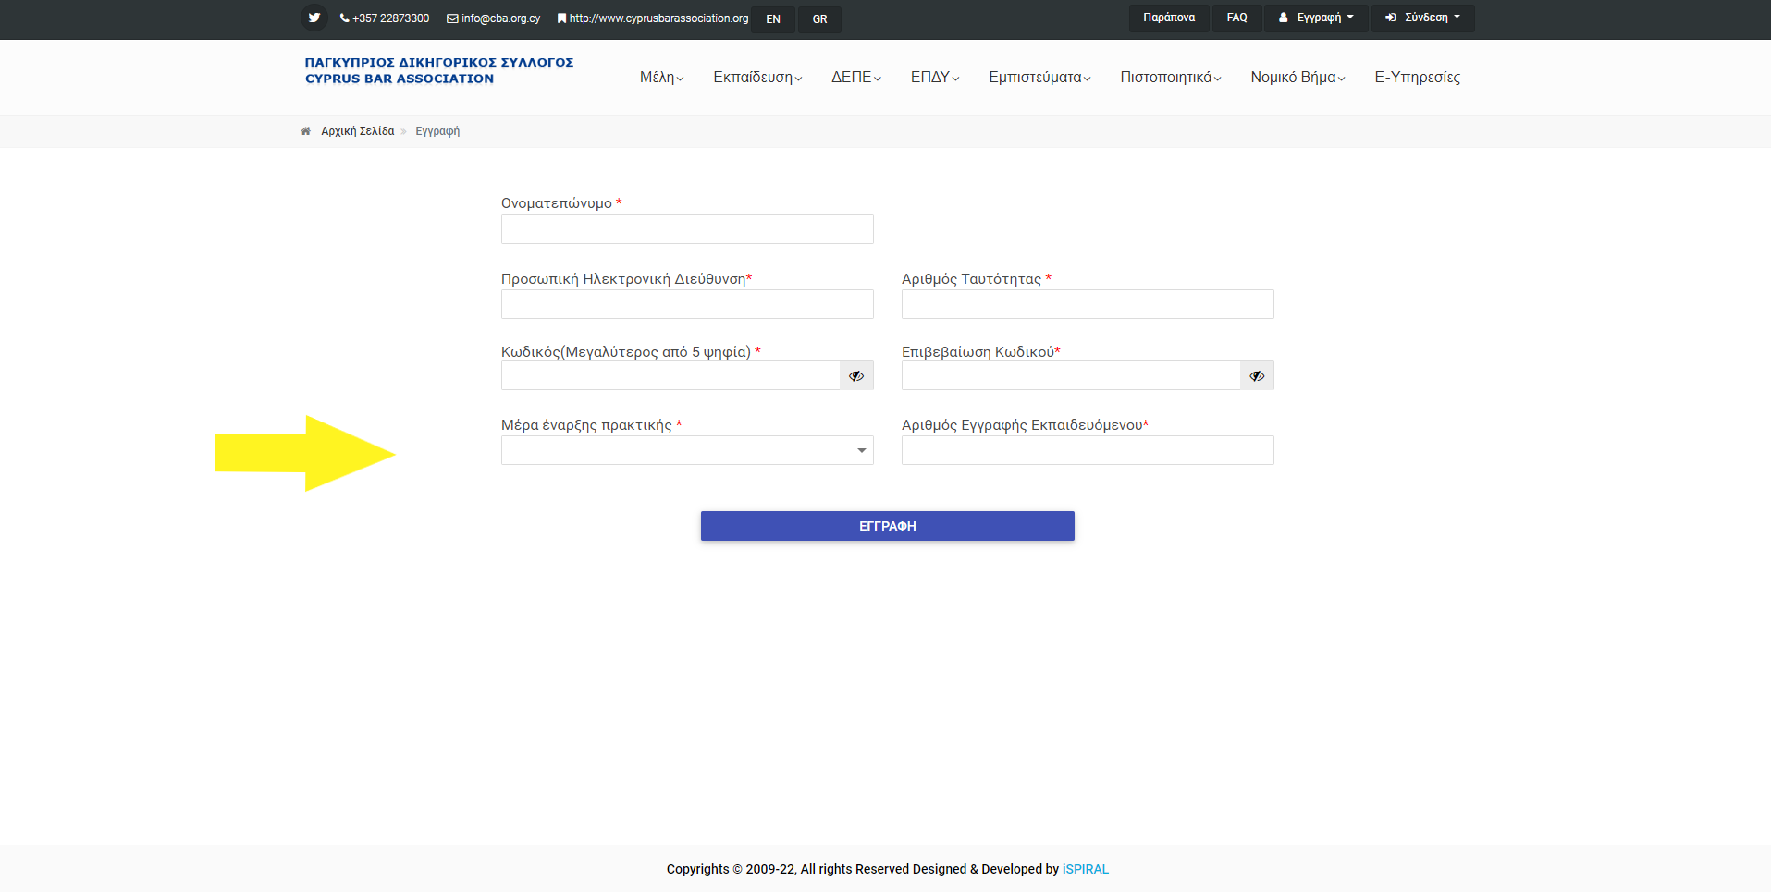
Creation OF ACCOUNT
In order to apply online, you must first create an account on the CBA platform.
Please fill in the requested fields, as shown below:
Important:
If more than 30 days have passed since the start date of your training, you will not be able to proceed to the next steps below.

Slide 5
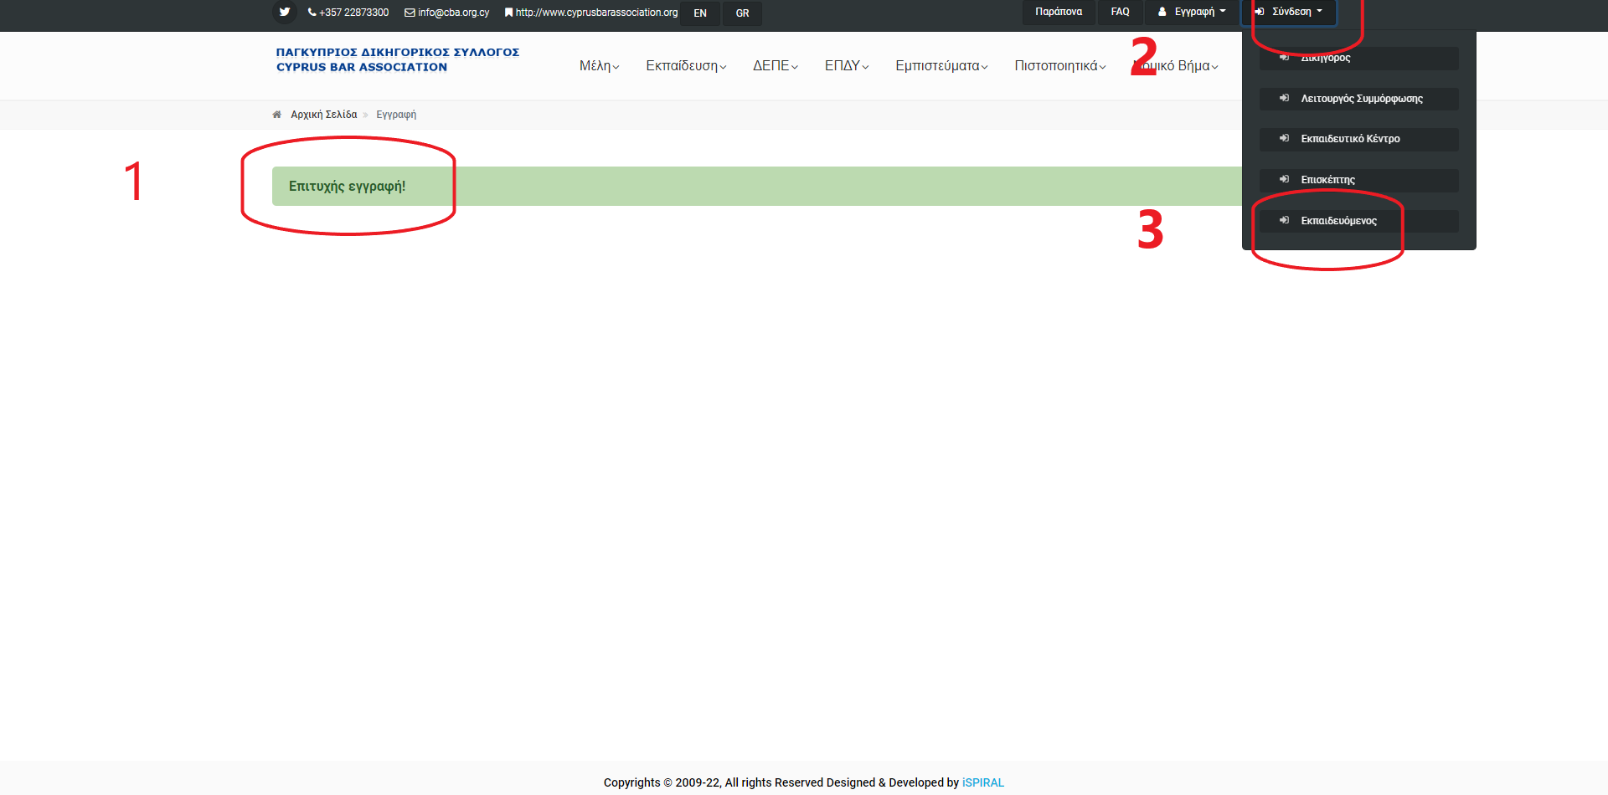
Login
After you sign up, log in as follows:
The message “Successful sign up” will appear (point 1).
Then click “Login” (see image next to point 1).
Finally select “Trainee” (see image next to point 2)
And log in as follows

Slide 6
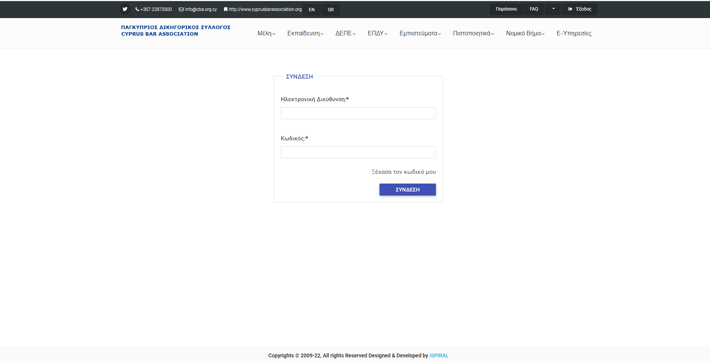
login
Fill in your details:
Email address
Password
“LOG IN”

Slide 7
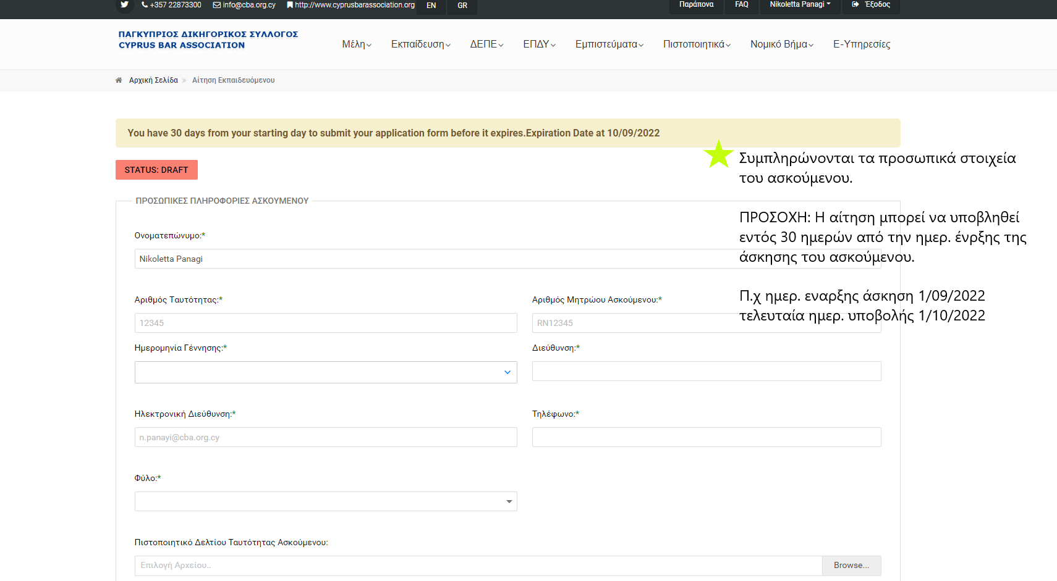
COMPLETION OF TRAINEE ADVOCATE PERSONAL DATA
Attention: THE APPLICATION MUST BE COMPLETED USING GREEK CHARACTERS ONLY
You have 30 days from the start date of your training to submit your application.
E.g. If the training start date is 1/09/2022 then the deadline for submitting the application is 01/10/2022.
Otherwise the system will not allow you to submit your application and you will be required to contact the Legal Council to change the start date of your training.
E.g. if the submission date is 03/9/2022 and the start date of your training is 01/08/2022 then the start date must change to a date later than 03/08/2022, so that there is sufficient time to submit the application.

Slide 8
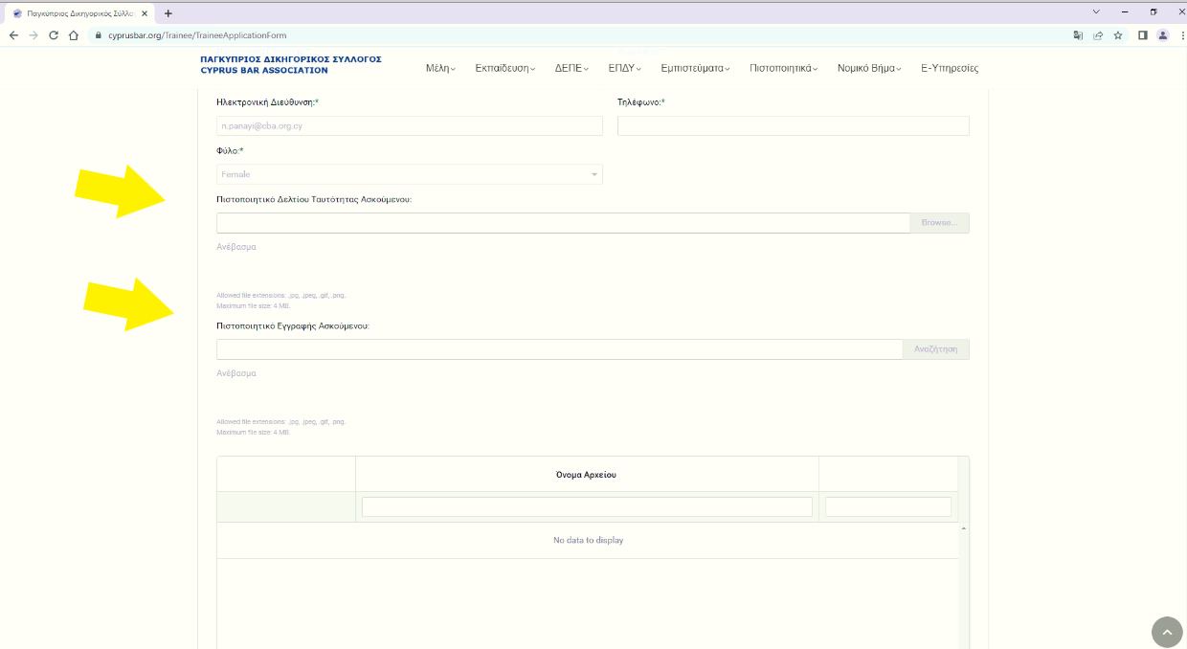
COMPLETION OF TRAINEE ADVOCATE PERSONAL DATA
Once you have filled in your personal data:
UPLOAD a copy of your Identity Card.
UPLOAD a copy of the trainee registration certificate from the Supreme Court (Register – yellow paper).

Slide 9
UPLoADING COPIES OF IDENTITY CARD AND TRAINEE REGISTRATION CERTIFICATE FROM The SUPREME COURT
In relation to the above:
“Browse” to find the file you wish to upload
Select “Open”
Click “Upload”.

Slide 10
COMPLETION OF LAW FIRM And INSTRUCTOR LAWYER INFORMATION
You must pay particular attention to this section, as it needs to be completed in accordance with the criteria of the Subsidy Project.
Specifically:
The instructor lawyer must have at least five years of experience since first registering with the CBA.
They must not have other trainees under their instruction.
They must have a renewed professional licence for the current year.
If the above requirements are not satisfied, the system will not allow you to proceed to the next stage.
In case you are not allowed to proceed, please check the following:

Slide 11
COMPLETION OF LAW FIRM And INSTRUCTOR LAWYER INFORMATION

Slide 12
IF THE Instructor DOES NOT FULFIL THE ABOVE CRITERIA:
IF the instructor lawyer does not have 5 years of experience, you must find another lawyer.
IF no other lawyer at the law firm in question fulfils the criteria, you must contact another law firm and apply again with the details of the new law firm.
IF the lawyer does not have a renewed licence for the current year, he or she must renew it, otherwise you will need to change law firm.
IF he or she is currently instructing another trainee who has not completed his or her training, you must either change instructor lawyer or change law firm.

Slide 13
INFORMATION ON THE PROGRESS OF THE APPLICATION
Once you have submitted your application, you will receive a message that your application has been successfully received and is being processed.
It will thereafter be examined/evaluated by the competent Department and you will be notified by email.

Slide 14
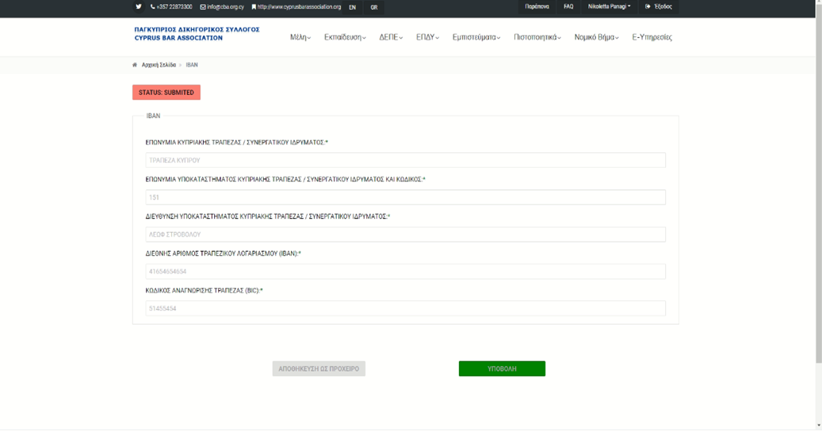
IBAN
WHEN you receive the message confirming the approval of your application, you must log in to your account and fill in your bank account details as shown in the image opposite.
Once you have made sure that all the information has been filled in correctly, submit the iban certificate by clicking submit.

Slide 15
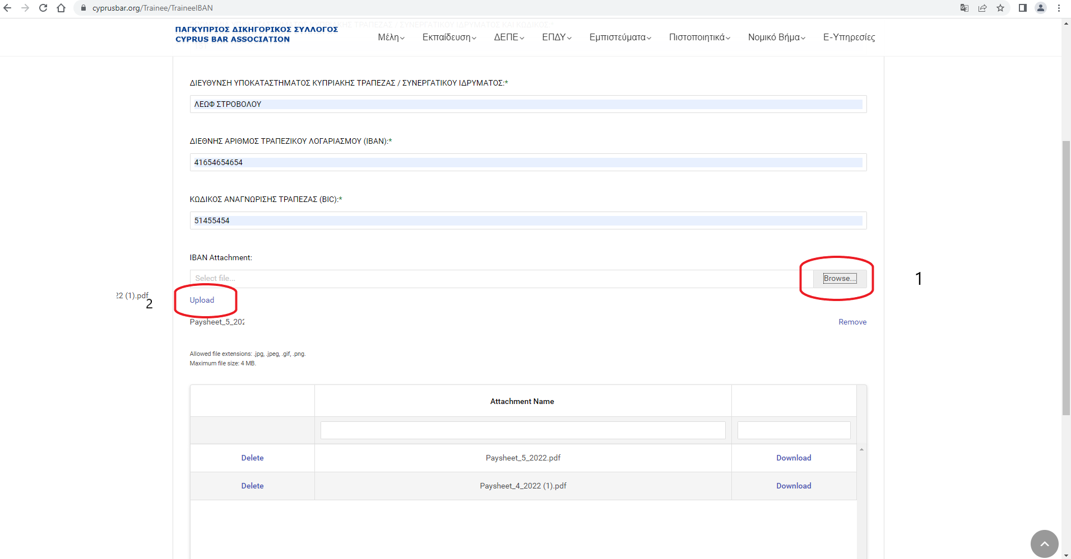
Iban certificate upload
To upload your IBAN Certificate, see the example opposite.
1.Click “Browse” and select the file.
2.Click “Upload” to upload the file.

Slide 16
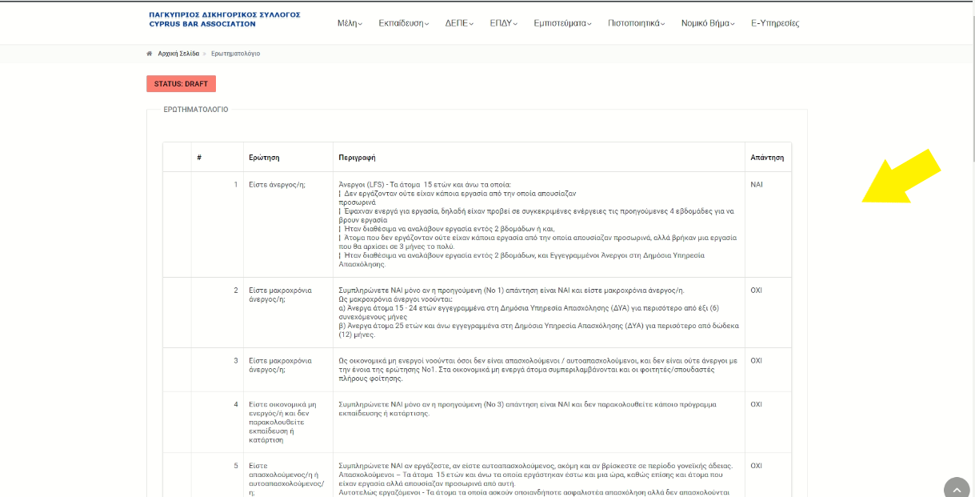
Opening questionnaire
You will then need to answer the opening questionnaire.
To view the questionnaire, log in to your account.
The first five questions are fixed and cannot be modified.
The rest of the questions are personal and should be answered based on your profile.

Slide 17
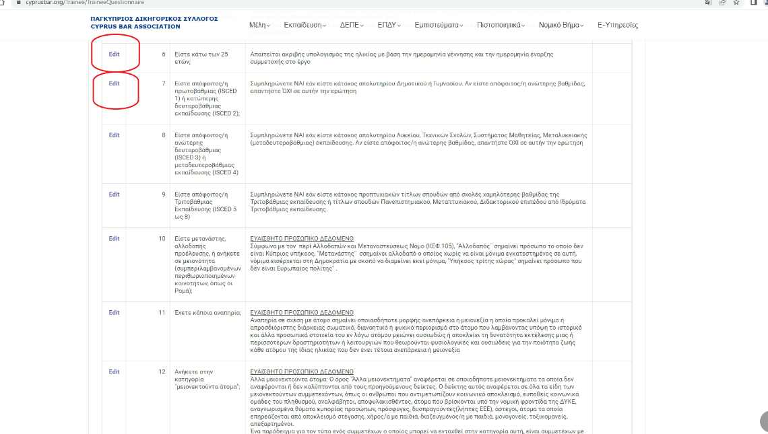
Opening questionnaire
As shown in the image opposite, next to each question there is an “edit” button.
Click it to view the answer options.
Select the answer that applies to you and then click “update”.
The procedure is described in the following slides.

Slide 18
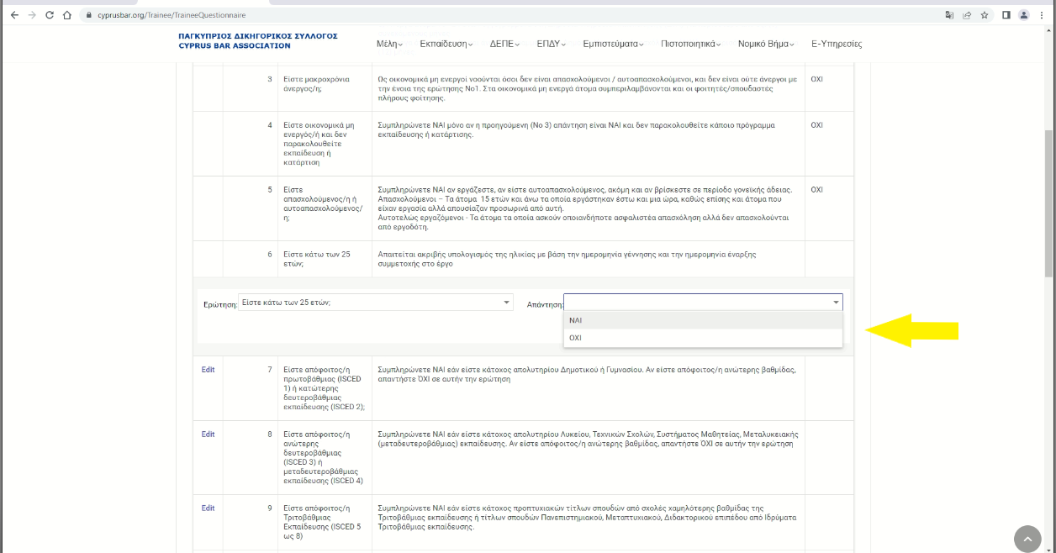
Opening questionnaire/ COMPLETION
When you click “edit” a window with the answer options will pop up. Select the appropriate answer.

Slide 19
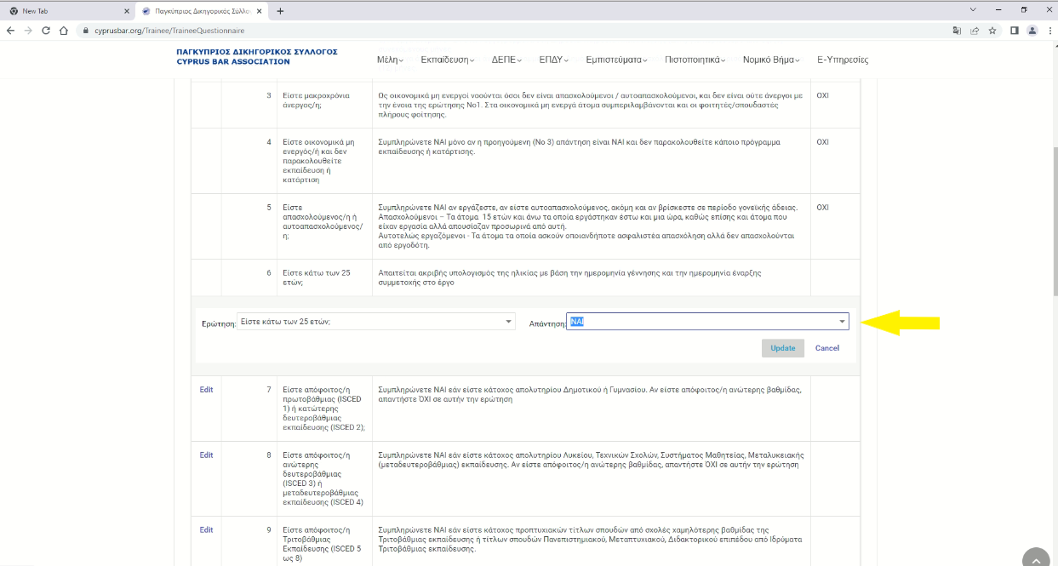
Opening questionnaire/ COMPLETION
Once you have selected your answer, click “update” to save the changes.

Slide 20
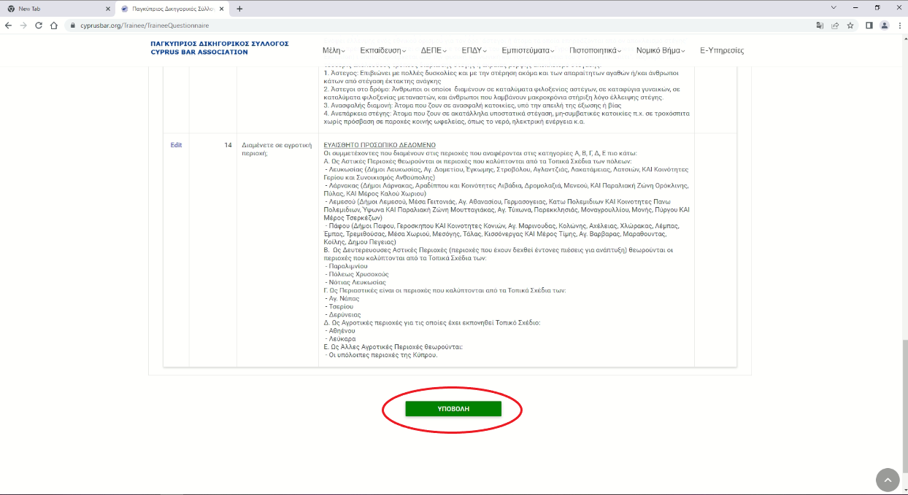
SUBMISSION OF OPENINg QUESTIONNAIRE
Once you have answered all the questions, click “Submit” so that we can receive your questionnaire.

Slide 21
PAYMENT PROCEDURE
All of the above steps are MANDATORY in order for your Approval forms to be evaluated for payment purposes.
Payment is made once a month - from the middle to the end of each month – in respect of the previous month.

Slide 22
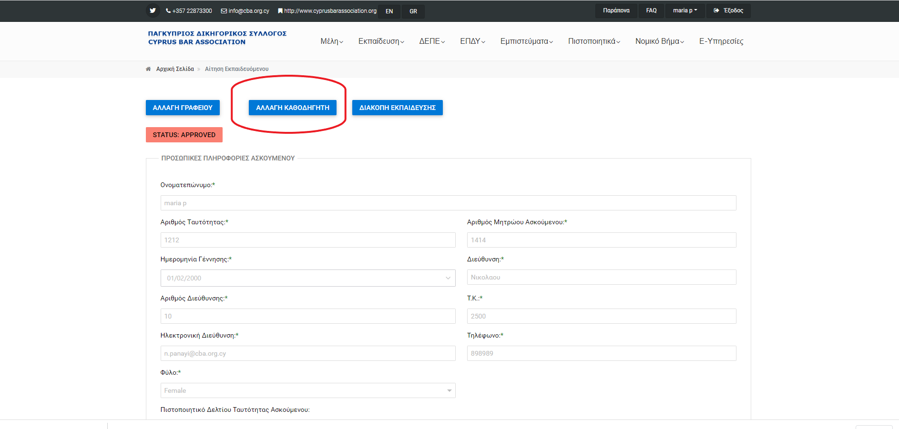
CHANGE OF INSTRUCTOR
You can change you Instructor Lawyer within the same Law Firm or the Law Office of the Republic.

Slide 23
CHANGE OF INSTRUCTOR
Note: A CHANGE OF INSTRUCTOR is ONLY possible in exceptional cases, provided the relevant reasons have been substantiated and approved by the Competent Department (e.g. the instructor leaves the law firm).
Follow the instructions described below (images in sl. 24):
Log in to your account as Trainee.
Click Browse to find the Application.
Click the blue “Change Instructor” button.
Select the date of change of instructor (i.e. the date on which the new instructor will take over).
Finally, click “Submit”.
A message will pop up indicating that your request to change instructor has been submitted and will be examined (sl. 28).

Slide 24
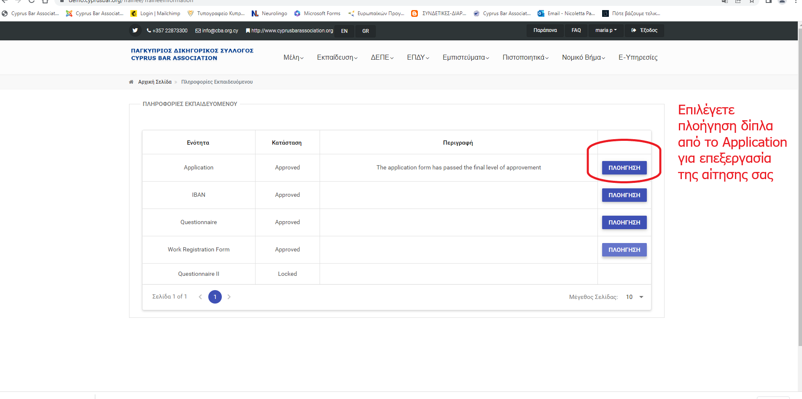
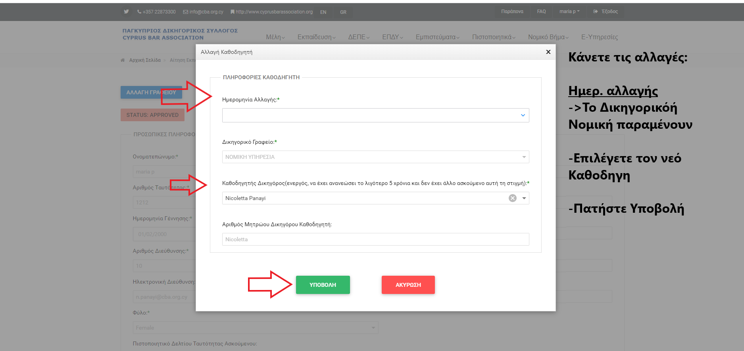
CHANGE OF INSTRUCTOR
2
1

Slide 25
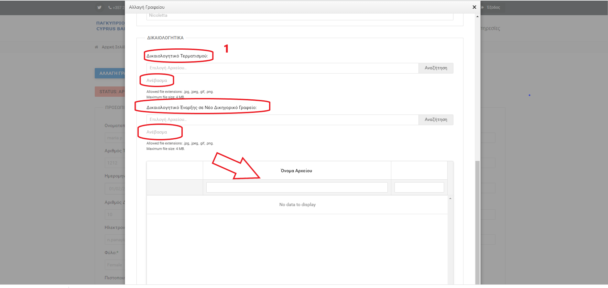
CHANGE OF FIRM
Note: A CHANGE OF FIRM is ONLY possible in exceptional cases, provided the relevant reasons have been substantiated and approved by the Competent Department (see page 7 of the GUIDE)
After you log in to your account:
Select the blue “CHANGE LAW FIRM” button.
Note 1: Enter a Termination Document: (Letter from the previous firm with date of termination and justification of the change)
Then click Upload (note 2).
Note 3: Enter Start to a New Law Firm: (Letter from the new Law Firm stating the start date). Then click Upload (4).
Note 5: Attachment Name:
The table must show the files you have uploaded. If it doesn’t, this means that they have not been successfully submitted.
Finally, click Submit to file your request so that it can be assessed.
2
3
4
5

Slide 26
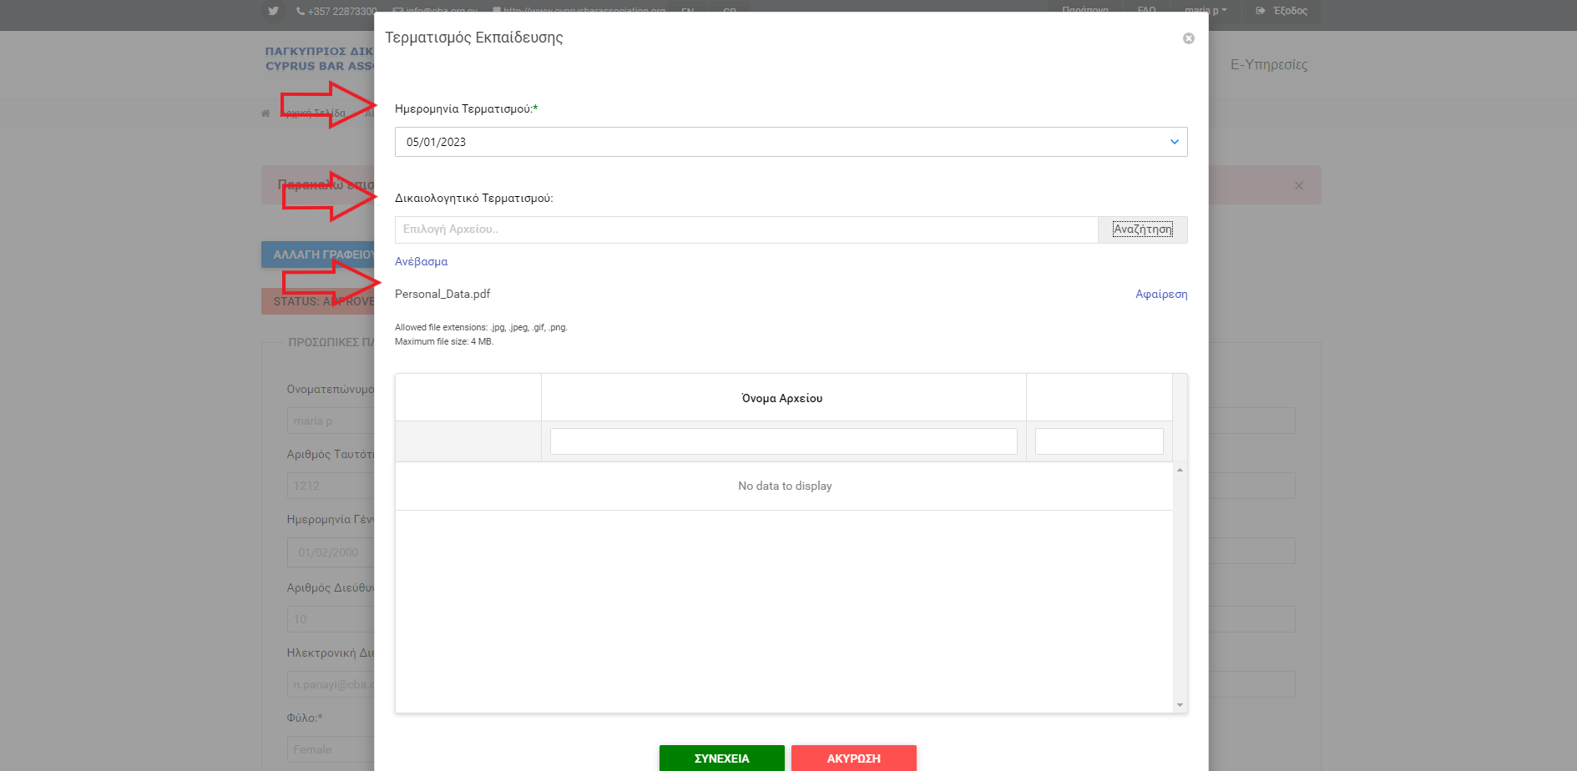
termination
Log in to your account.
Select the blue “TERMINATION” button
Fill in all the fields:
End Date of Training
Termination Attachment
Termination Document
Click Upload
The File should appear in the Attachment Names.
Click “Continue”

Slide 27
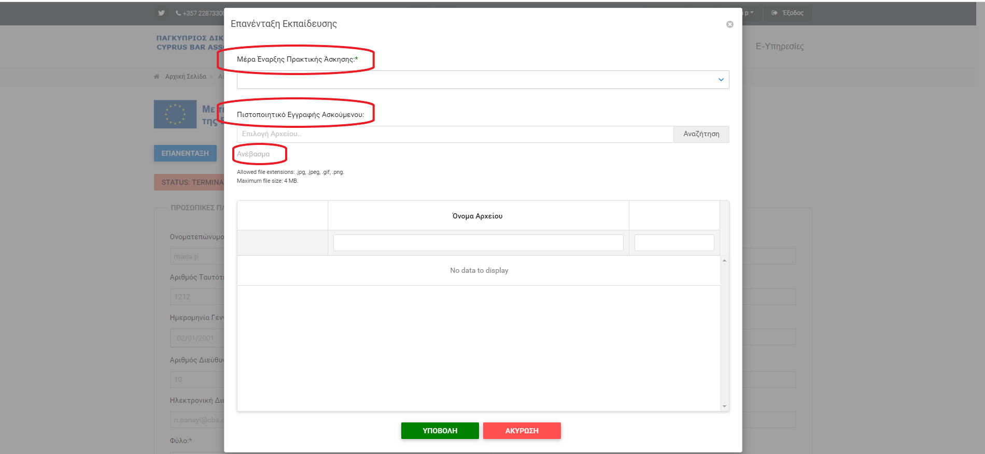
REINTEGRATION
Click the blue “REINTEGRATION” button
See the image opposite:
Enter the reintegration date from the drop-down menu.
Attach the new certificate from the Supreme Court bearing the new date.
Click Upload.
To make sure your submission is successful, check that the file appears in the attachment names.
- Click Submit

Slide 28
REINTEGRATION
When you submit a request for reintegration, your application will appear in draft status, so that you can enter the details of your new Law Firm or any changes relating either to your application or to your bank account.

Slide 29
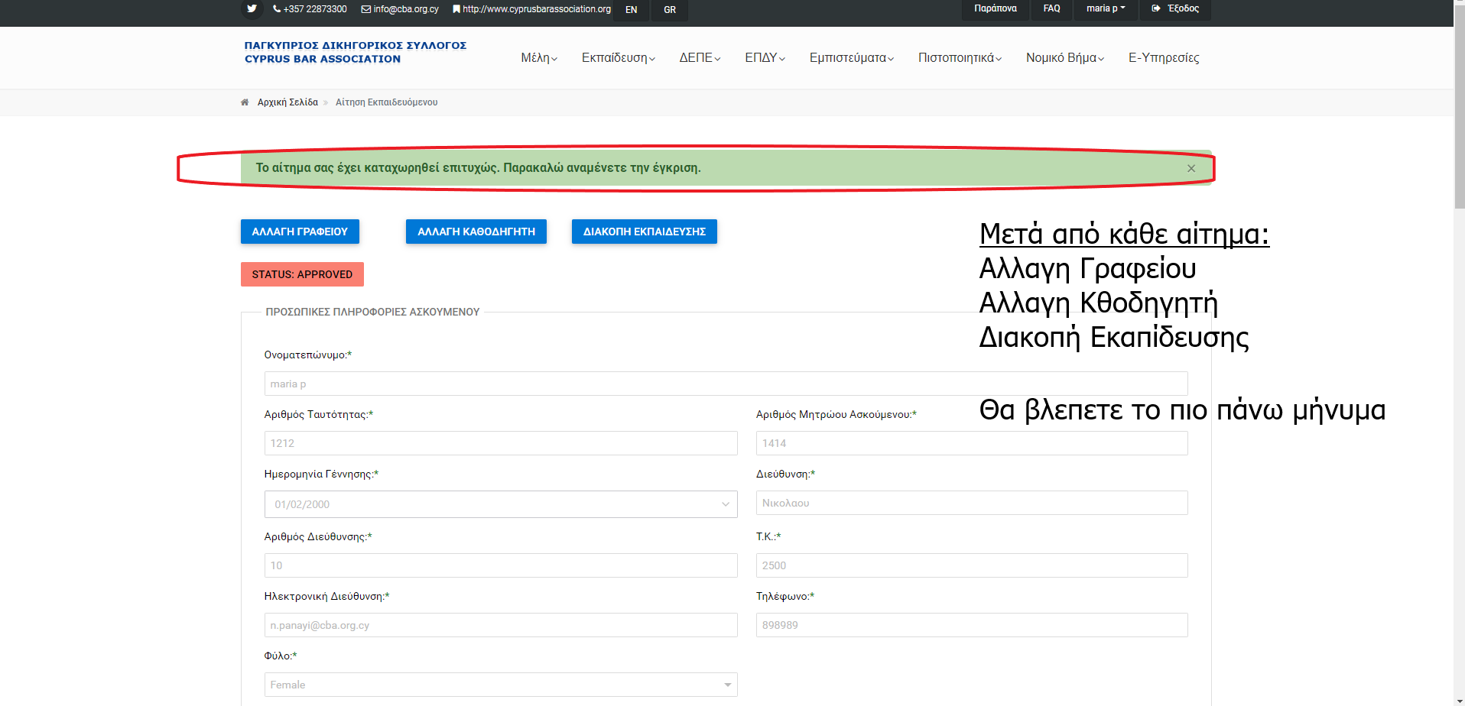
CHANGE OF FIRM / CHANGE OF INSTRuCTOR / TERMINATION / REINTEGRATION
After you submit a request, the message in the image opposite will appear.
This confirms that the procedure has been successfully completed and the request will be assessed by the Trainee Department.
Once your request has been assessed, you will be notified accordingly by email.
Επανένταξη

Slide 30
WORK REGISTRATION FORM
WORK REGISTRATION FORM – CORRECT COMPLETION:
The form is submitted in the period from the last working day of each month up to the first five WORKING days of the following month (e.g. for November 2022, from 30/11 to 7/12 excl. the weekend of 3-4/12)
2. The form will start from the 1st day of the month, even if that day is:
a Saturday or a Sunday
a bank holiday
included in the annual leave
3. The last day of the month must also be completed/recorded (otherwise it will be deducted).
4. The date of signature on the form must be within the submission deadline.

Slide 31
WORK REGISTRATION FORM – correct completion
CORRECT COMPLETION OF THE FORM:
The form must:
Be completed correctly and list the tasks performed in a descriptive manner (more details),
Not include repetition symbols and/or repetitions of the same tasks without explanation.
Bear the seal of the law firm in which the trainee is placed.
The “Comments” section must by completed by the Instructor.
The “Absences” section must be completed.
State the date, the instructor’s name in full letters and include his or her signature.
The relevant form must be submitted in its entirety, as a PDF file and not as an image (jpg).
In case of sick leave of more than 2 days, a medical certificate/supporting document must be attached, otherwise these days will be deducted from the monthly payment of the allowance or as the Department/Committee may deem appropriate.
In case of absence, the days of absence (number), the exact dates and the reason for the absence (e.g. annual or sick leave) must be filled in.

Slide 32
WORK REGISTRATION FORM – CORRECT COMPLETION
Following the above:
Once the form has been completed in accordance with the above instructions, you will receive a message that it has been accepted (“accept”).
Otherwise, you will receive a message that it has been rejected (“reject”) and the reason for the rejection. The trainee must correct the form in accordance with the instructions provided and the instructor must submit the corrected form again in accordance with the instructions in slide 30 within the deadline. ATTENTION ** the notification email may be in your junk folder**.
In case the deadline has passed, you must submit with your late form a letter/request providing justification, together with all the supporting documents for review (slide 38).

Slide 33
WORK REGISTRATION FORM – SUBMISSION BY THE INSTRUCTOR
The work registration form can ONLY be submitted by the instructor lawyer via his or her account in the CBA portal.
Due to the completion of the training period, the last work registration form must be submitted on trainee’s lawyer last working day
The trainee advocate can also view the form via his or her account, as well as save it.
Therefore, for purposes of VERIFICATION:
The trainee must check whether his or her form has been submitted correctly and within the prescribed deadline.

Slide 34
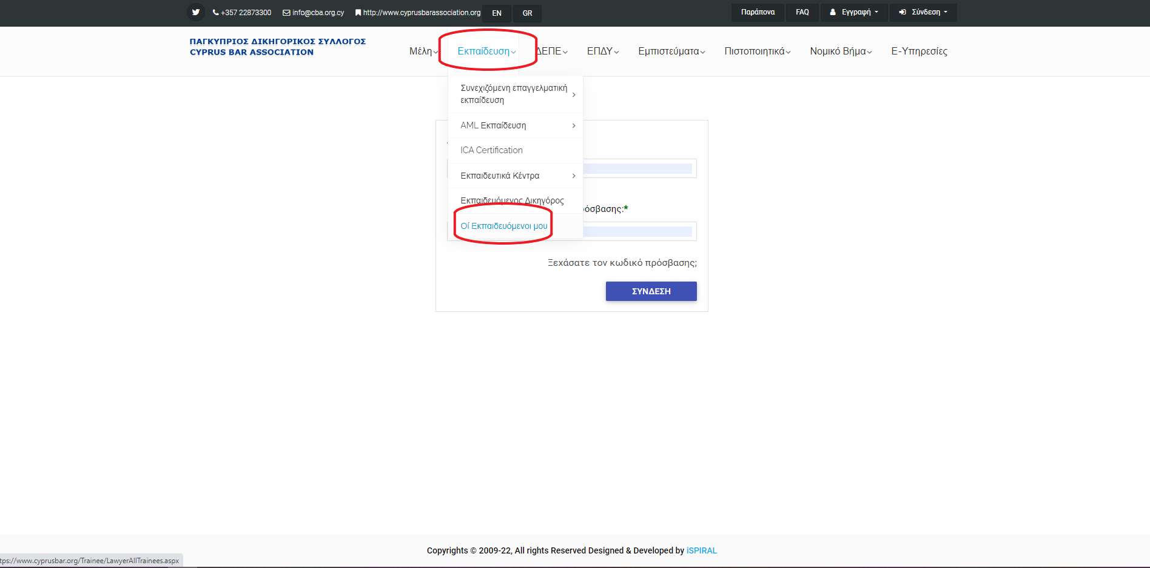
SUBMISSION OF FORM BY THE INSTRUCTOR LAWYER
INSTRUCTOR:
Click “log in”
Once you are logged in, select:
Education
My Trainees

Slide 35
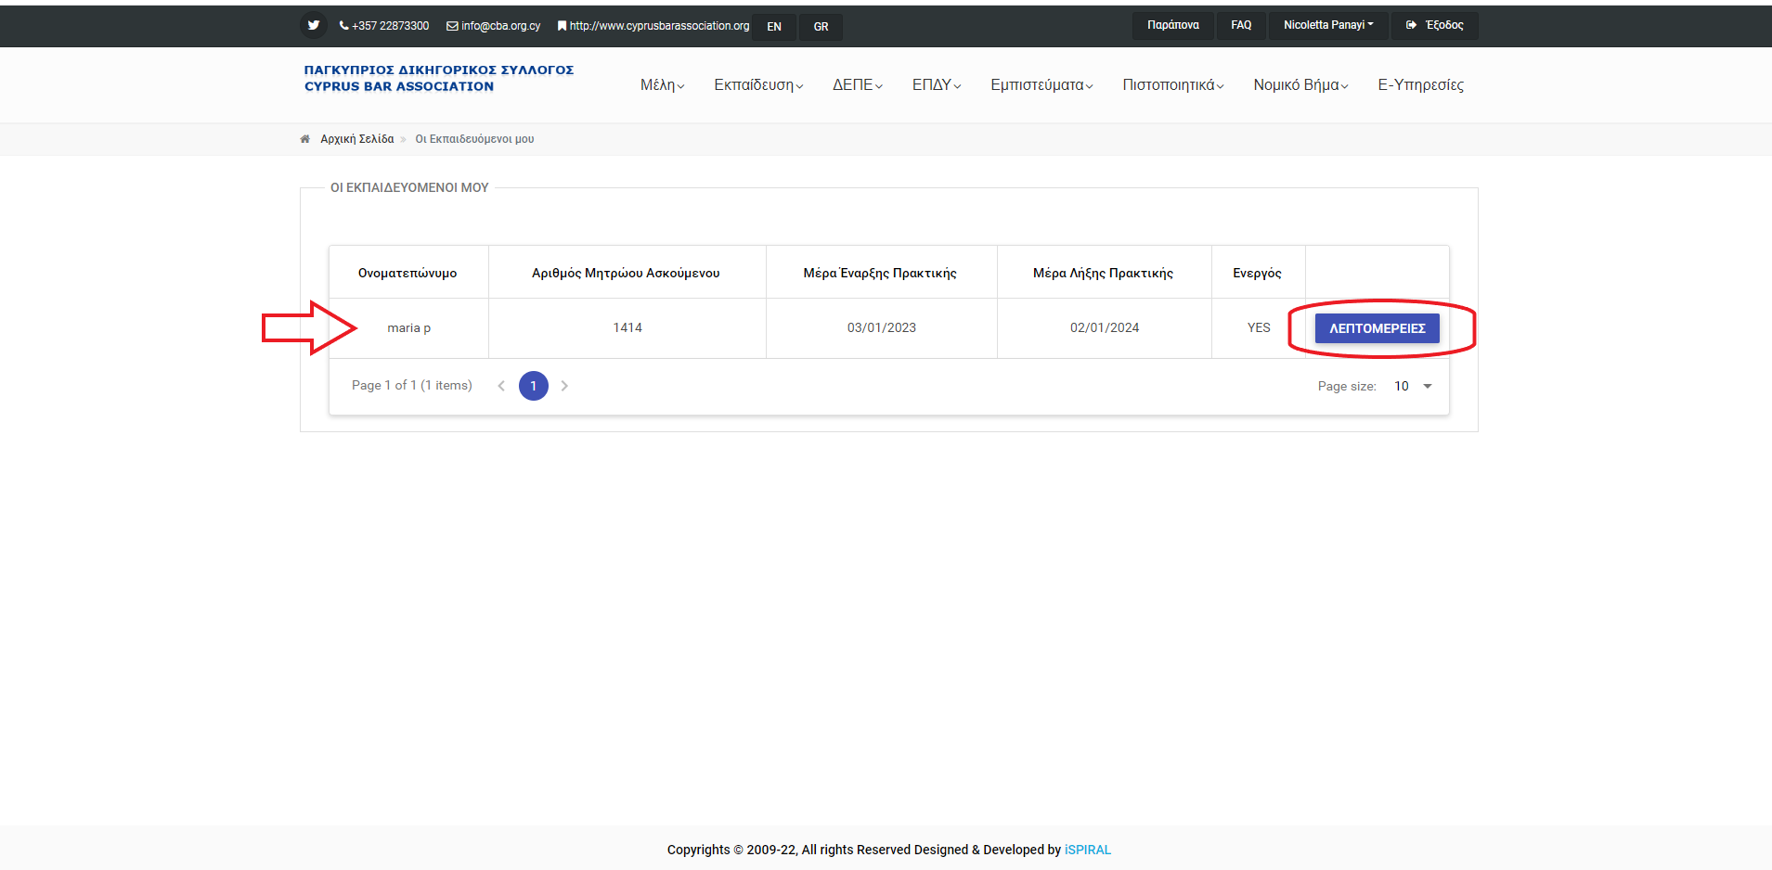
CONTINUE
Once the tab with your trainee’s details opens, as per the image opposite
Click “DETAILS”

Slide 36
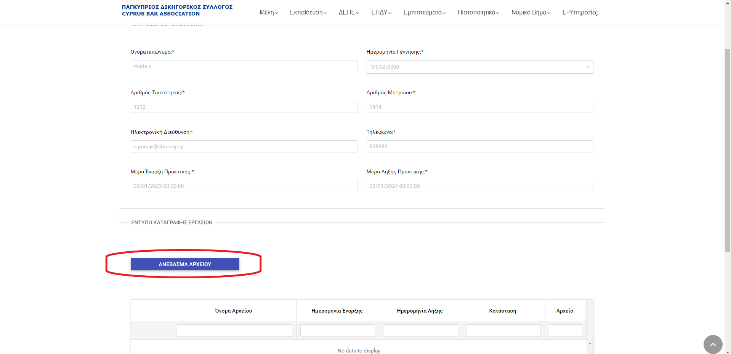
CONTINUE
Once you click “DETAILS”
the tab as per the image opposite will open.
Select “UPLOAD FILE”.

Slide 37
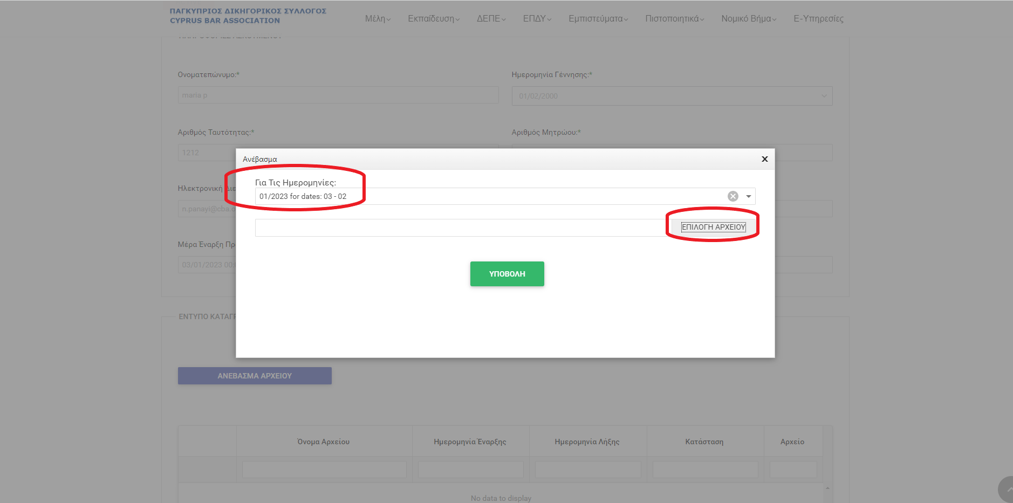
cONTINUE
Select the deadline.
Click “Select File”,
“Upload” and then “SUBMIT”.
To make sure that the file has been uploaded successfully, check if it appears in the Table below.

Slide 38
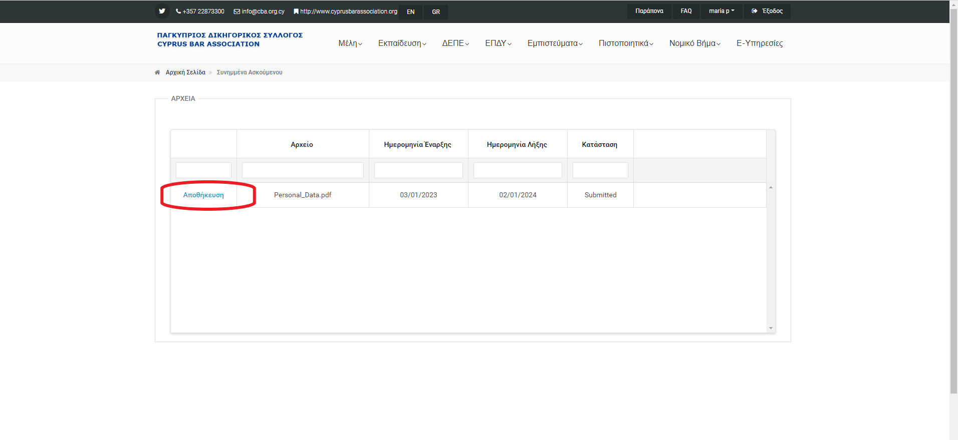
VERIFICATION BY THE TRAINEE ADVOCATE
The Trainee Advocate:
Must log in to his or her account.
Next to the “Work Registration Form”
Select “BROWSE”
to save and check that his or her form has been submitted, as per the image opposite.

Slide 39
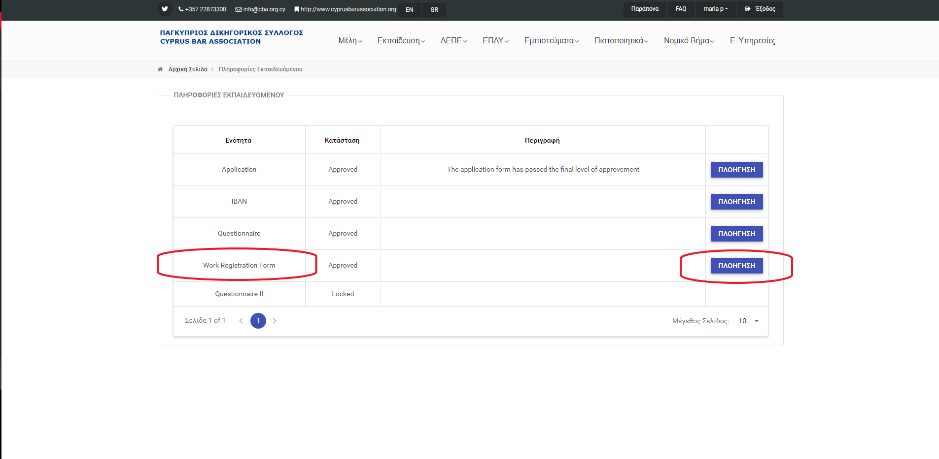
LATE SUBMISSION OF THE WORK REGISTRATION FORM
If the form has not been submitted within the prescribed deadline for valid reasons, follow the steps below to submit the relevant justification:
Trainee Advocate:
- Sign in as Trainee
- Browse to the Work Registration Form
- Upload the justification letter prepared by
the firm or by you together with any
supporting documents you may have.
Instructor:
- Submit the late form as per the instructions
above

Slide 40
END OF TRAINING QUESTIONNAIRE (questionnaire ιι)
The completion of the end of training questionnaire is a prerequisite for the payment of the last allowance at the end of the twelve-month training.
This questionnaire unlocks and is available for completion on each trainee’s last day of training.
Select “BROWSE”, fill in the questionnaire and click “SUBMIT” to register it.
If you do not fill in this questionnaire, you will not be paid.

Slide 41
END
For more details on the Subsidy Project for Trainee Advocates, please visit the CBA website:
http://www.cyprusbarassociation.org/index.php/el/for-trainees/subsidy-project-for-trainee-advocates-2017-2023
This presentation gives advice on the procedures relating to the submission of forms. For details on the obligations of Trainee Advocates and Instructor Lawyers, consult your GUIDE.
Please check our website daily for any new ANNOUNCEMENTS by the Department.
THANK YOU

