Slide 1
Ενεργειακή Μετάβαση:
Ρυθμιστικές προκλήσεις για την ολοκλήρωση της αγοράς ηλεκτρισμού στην Κύπρο
Δρ. Ανδρέας Πουλλικκάς
M.Phil, Ph.D, D.Tech, FIET
Πρόεδρος Ρυθμιστικής Αρχής Ενέργειας Κύπρου
apoullikkas@cera.org.cy

Slide 2
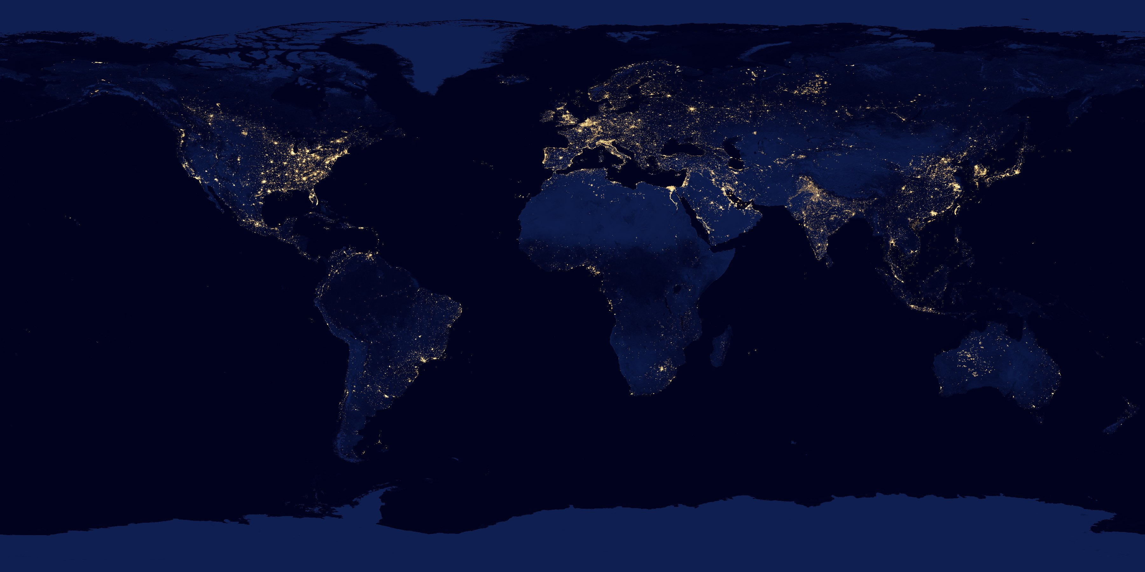
Contents
EU energy strategy – energy transition towards towards 2050
Cyprus current electricity system – system characteristics
Challenges of energy transition in island systems – solutions to isolated systems
Long term energy strategy for Cyprus – towards hydrogen economy

Slide 3
EU energy strategy
Energy transition towards 2050

Slide 4
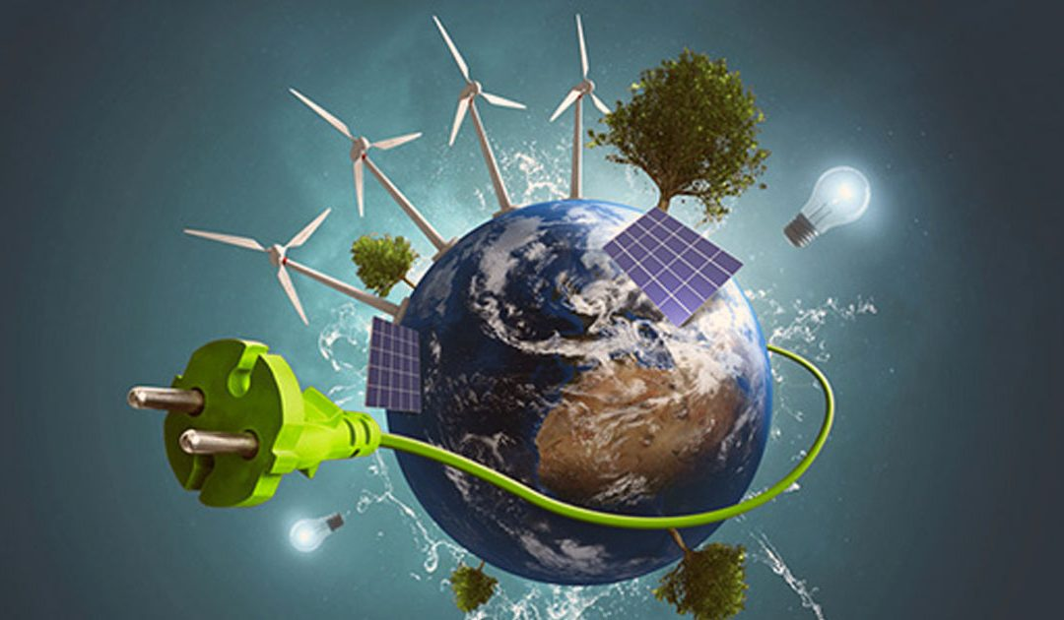
Energy transition
greenhouse gas reduction
  EU: climate neutral by 2050
sustainable production and consumption
third energy revolution
competition in electricity and natural gas markets
security of supply
3

Slide 5
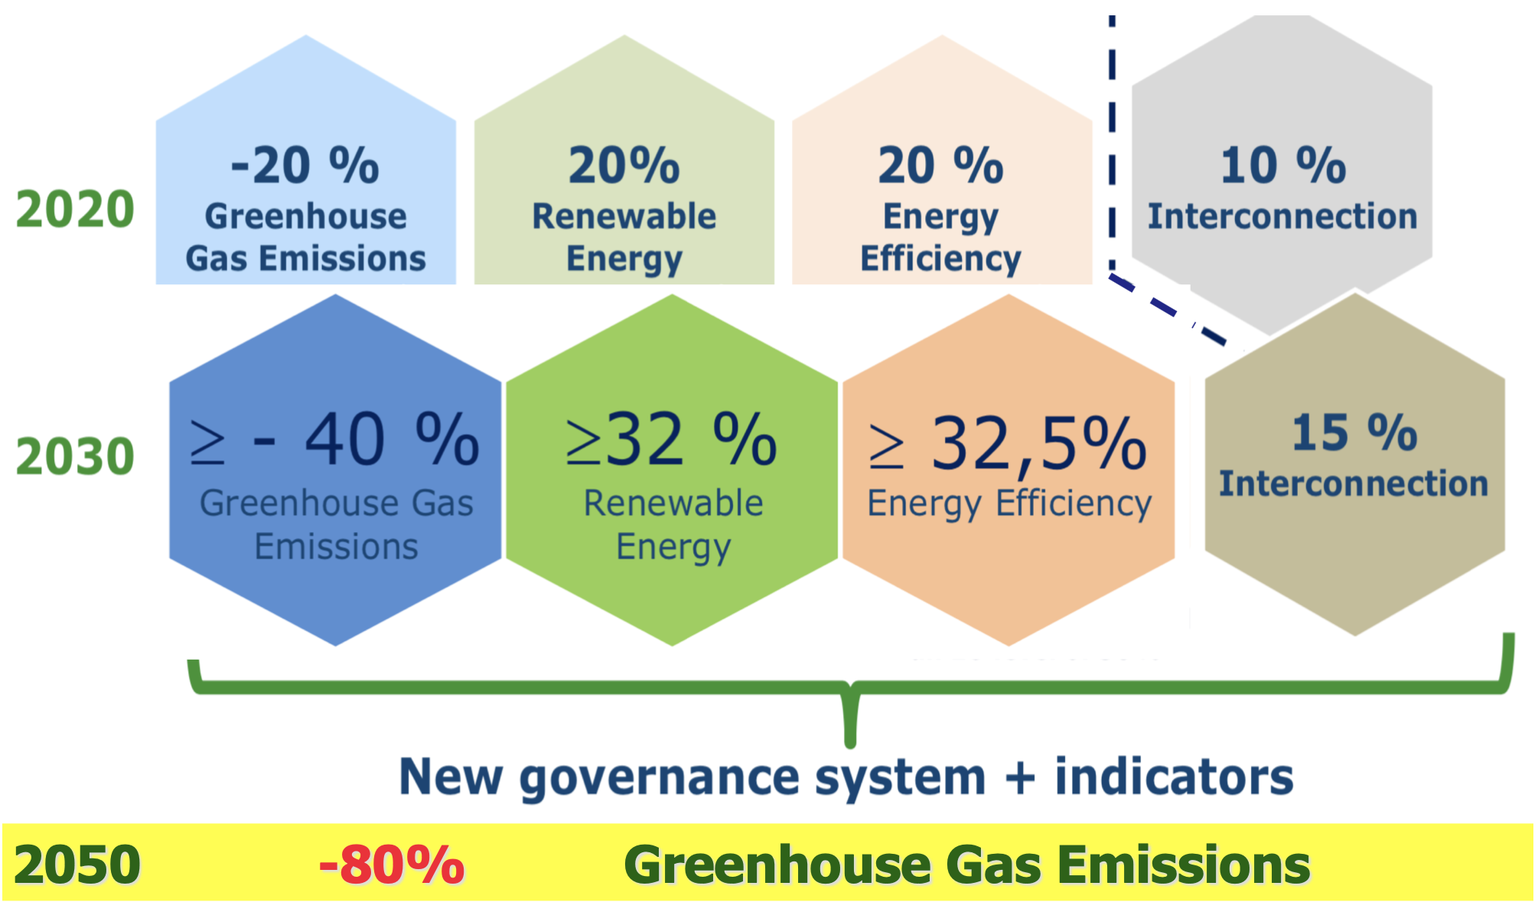

EU medium and long term targets
Fit for 55 package & RePowerEU plan
-55%
>45%
>41,5%
2050
Climate-Neutral
(an economy with net-zero greenhouse gas emissions)

Slide 6

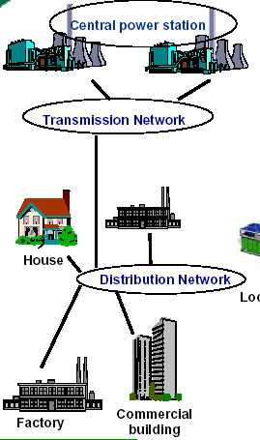
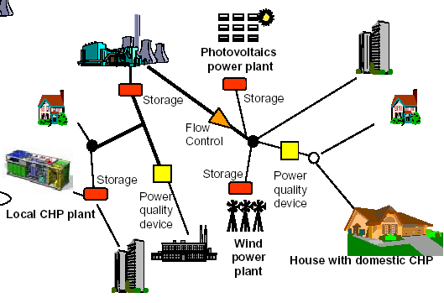
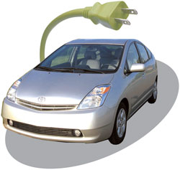
Future power systems*
Tomorrow: CCS, RES, DG and hydrogen storage, smartgrids
2010
Plug in vehicles
* Poullikkas A., 2013, Renewable Energy: Economics, Emerging Technologies and Global Practices, ISBN: 978-1-62618-231-8

Slide 7
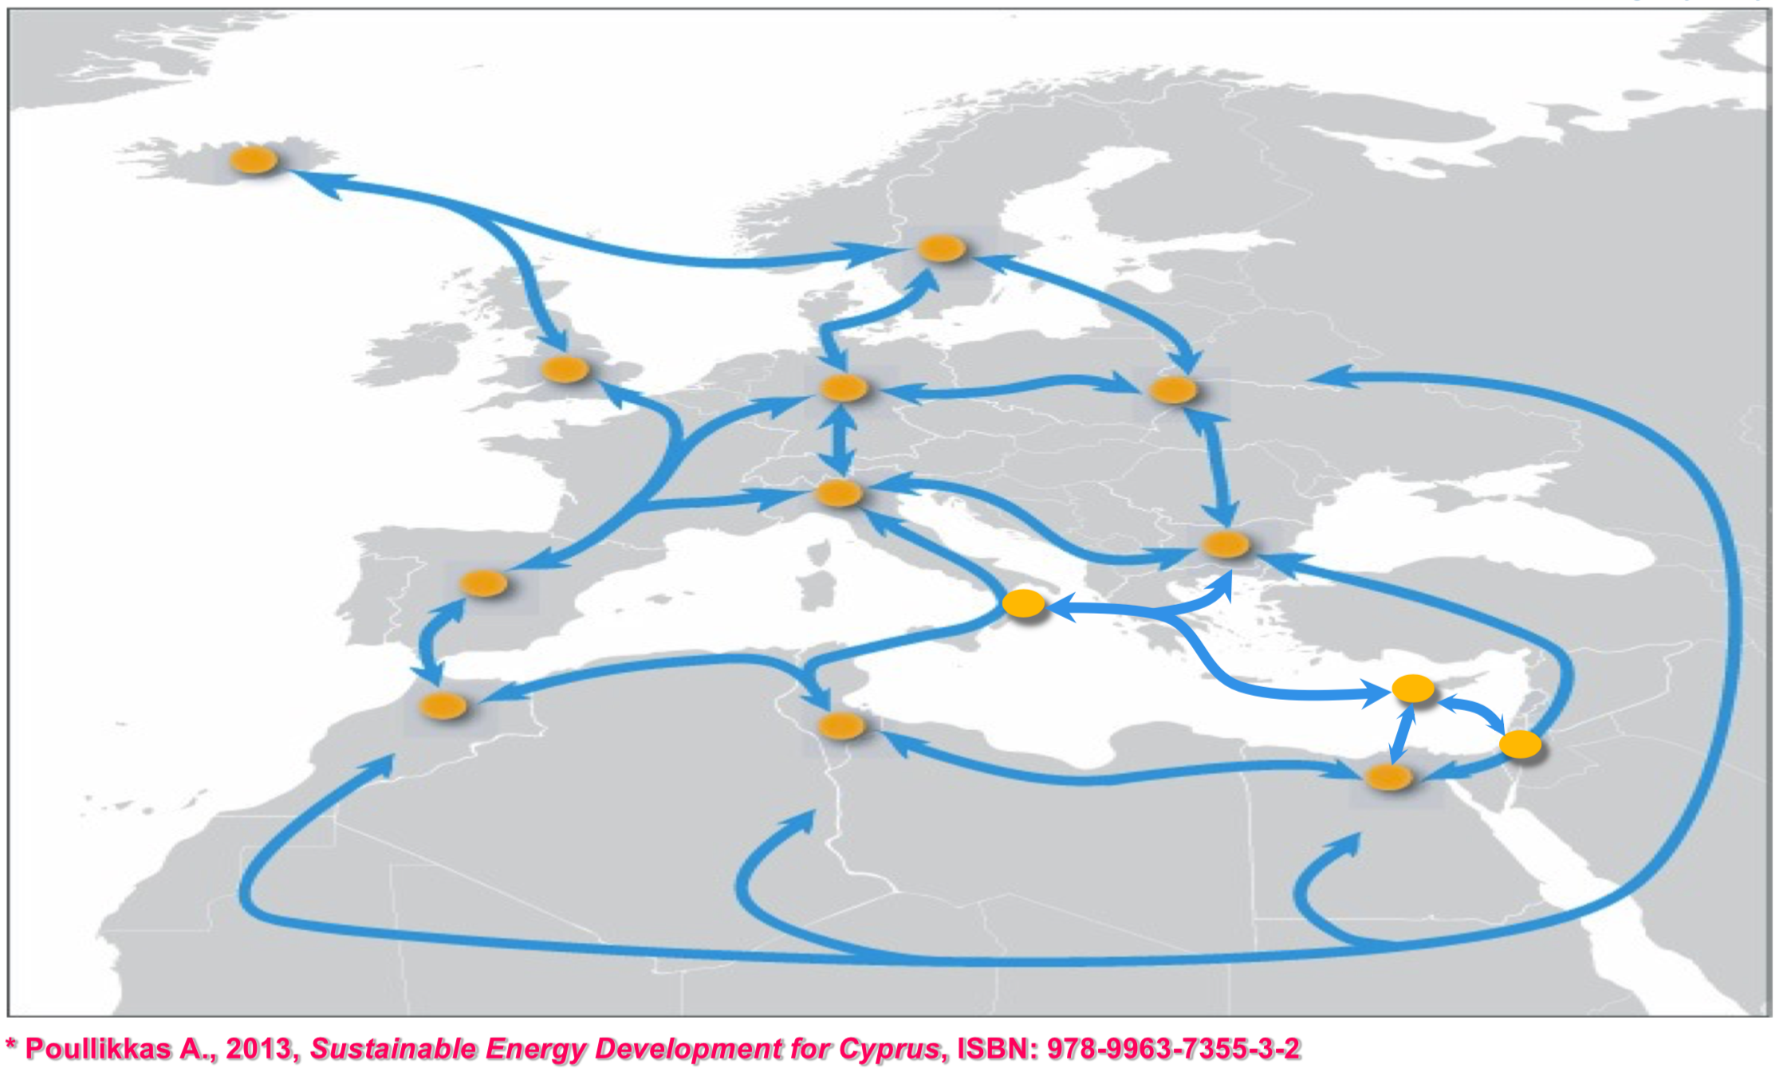
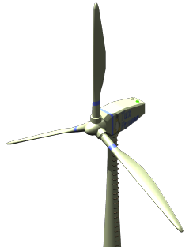
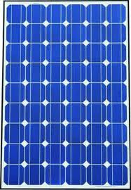
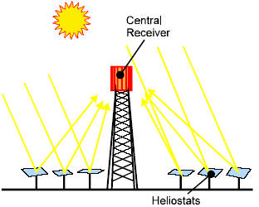
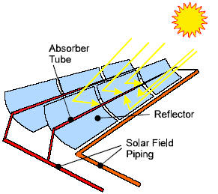
The Super Smart Grid after 2050*
(may allow for 100% RES)
H
G
H
S
B
H
B
B
B
M
B
H

Slide 8
CO₂ emissions from green hydrogen power generation* (cont.)
* Nicolaidis P., Poullikkas A., 2023, “Power-to-hydrogen concepts for 100% renewable and sustainable energy systems”, Hydrogen Economy

Slide 9
Cyprus current electricity system
System characteristics

Slide 10
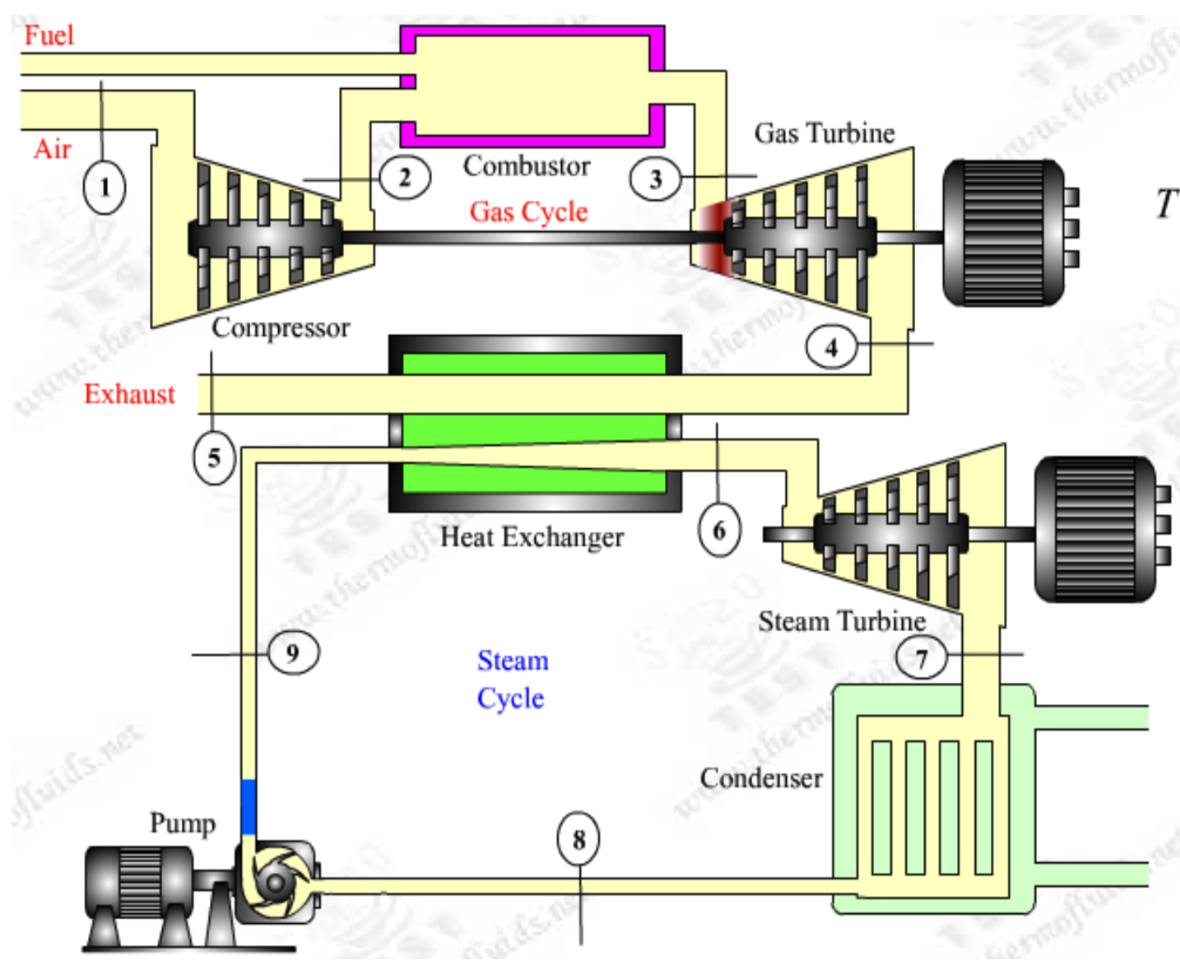
Existing power generation system
  Steam turbine units (HFO)
    Dhekelia power station 6x60MWe
    Vasilikos power station 3x130MWe
  Internal combustion engines (HFO)
    Dhekelia power station 6x17.5MWe
  Combined cycles (Diesel)
    Vasilikos power station 2x220MWe
  Gas turbine units (Diesel)
    Moni power station 4x37,5MWe
    Vasilikos power station 1x38MWe

Slide 11
Existing power generation system (cont.)
  Renewables
    PVs: 522MWe
    Wind: 157MWe
    Biomass: 13MWe
  Total installed capacity:
    Conventional: 1483MWe
    Renewables: 692MWe

Slide 12
RES-E installed capacity*
* www.cera.org.cy

Slide 13
Total electricity production per year*
* www.cera.org.cy

Slide 14
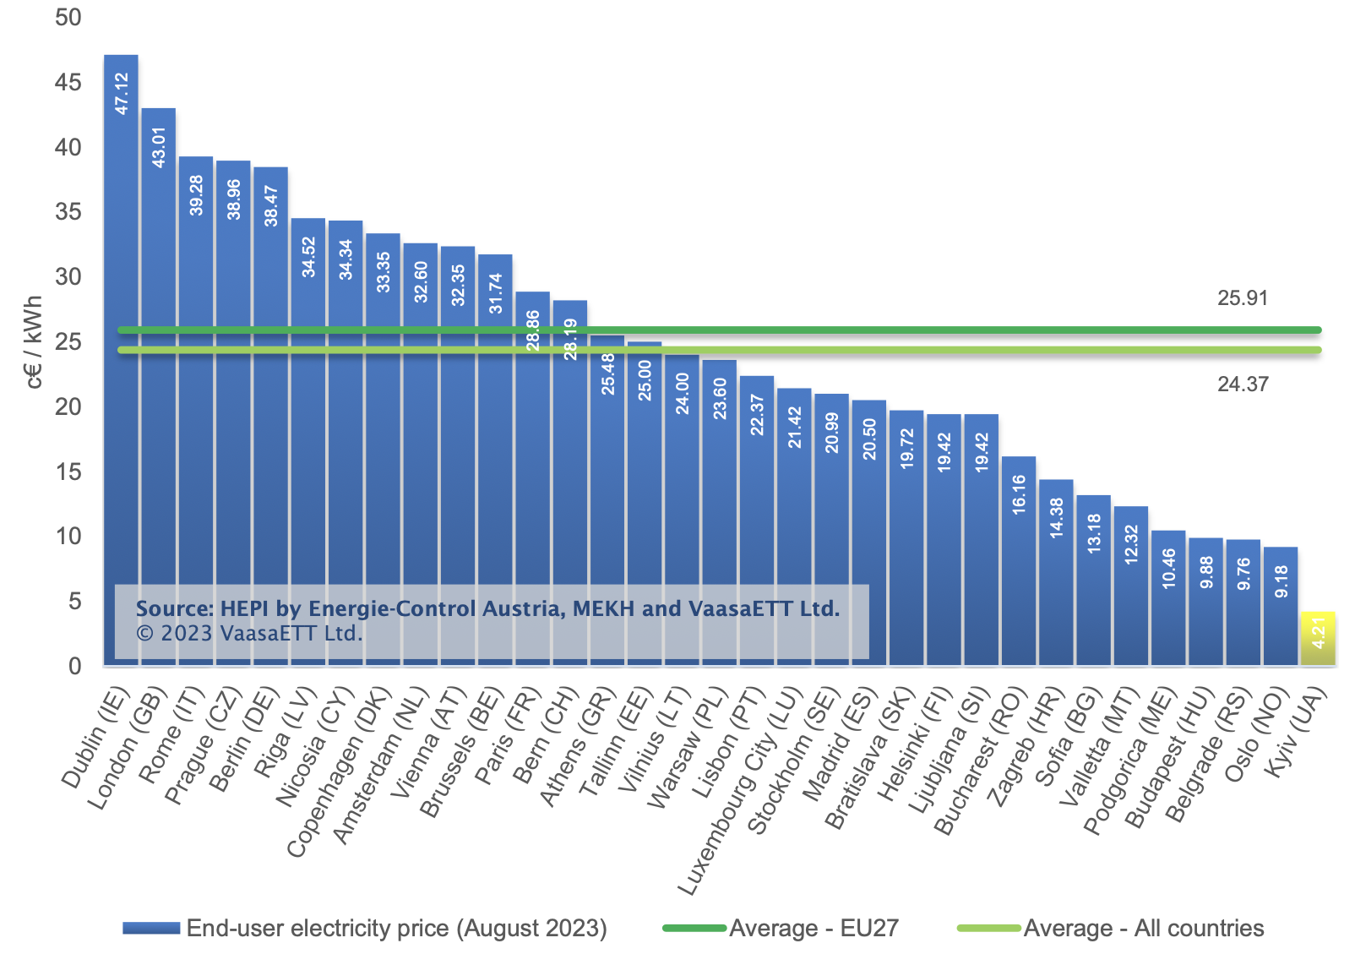
EU statistics (Aug 2023)*
* Household Price Index

Slide 15
Electricity price - Position of Cyprus in EU*
* Eurostat

Slide 16
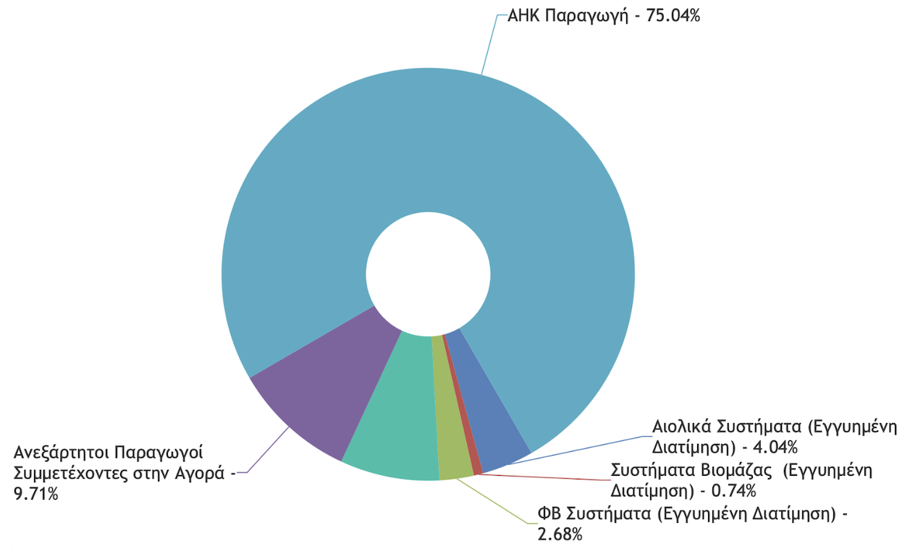
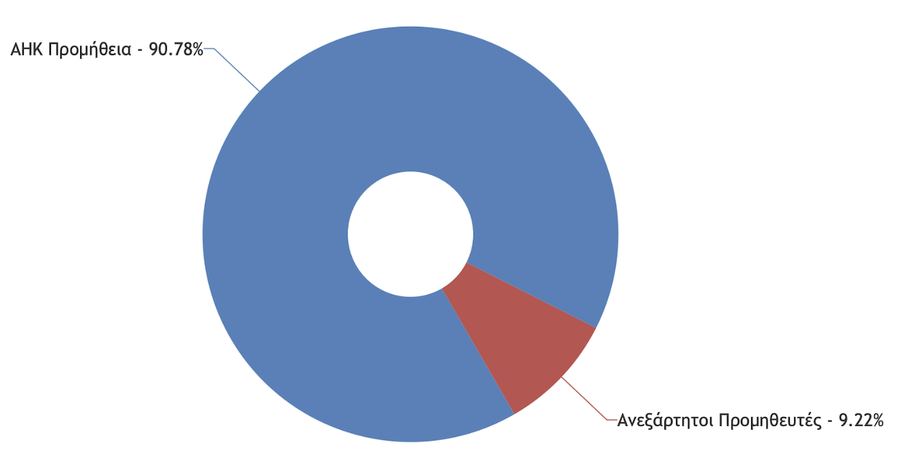
Market share (June 2023)
Wholesale market
Retail market
Source: www.cera.org.cy

Slide 17
Challenges of energy transition in island systems
Solutions for isolated systems

Slide 18
Characteristics of isolated electricity systems*
  High fuel costs
    use of oil derivatives
    high CO₂ emissions (additional cost)
  Economies of scale cannot be adequately exploited
    generation units cannot exceed a certain size since the loss of a unit would mean the loss of a high percentage of the entire system
  Need to maintain high reserve capacity to ensure power system reliability
  The smaller the electrical system size, the more the expenses will be
* Poullikkas A., 2015, Sustainable Energy Policy for Cyprus, ISBN: 978-9963-7355-6-3

Slide 19
The solution*
  Increase system flexibility
    integrate RES into electricity market
    use natural gas, storage and RES for power generation
    promote e-mobility (V2G technology - bidirectional flow of electricity between the electric car and the grid)
  Establish electricity interconnections
    with EU internal electricity market (the island of Cyprus is the only non-interconnected Member State)
  Production of hydrogen (energy carrier)
    from RES and natural gas
* Poullikkas A., 2016, Fundamentals of Energy Regulation, ISBN: 978-9963-7355-8-7

Slide 20
Effect of PV generation on load curve (the ‘duck curve’)*
Need for storage and flexible technologies
* Poullikkas A., 2016, “From the ‘camel curve’ to the ‘duck curve’ on electric systems with increasing solar power”, Accountancy

Slide 21
Interconnection between countries in the EU (% of installed capacity)

Slide 22
CERA Energy Transition Regulatory Decisions
  Regulatory Decision 01/2017 (ΚΔΠ 34/2017): A detailed schedule for the implementation of EU electricity market target model
  Regulatory Decision 02/2018 (ΚΔΠ 259/2018): The mass installation of an Advanced Metering Infrastructure including smartmeters to all electricity consumers
  Regulatory Decision 02/2019 (ΚΔΠ 204/2019): The establishment of basic principles of a regulatory framework for the operation of electricity storage systems in the wholesale electricity market
  Regulatory Decision 03/2019 (ΚΔΠ 224/2019): The redesign of the power grid to become smart and bi-directional in order to allow integration of large quantities of renewable energy sources in combination with energy storage systems

Slide 23
CERA Energy Transition Regulatory Decisions (in preparation)
  Regulatory framework: Energy communities and Renewable energy communities
  Regulatory framework: Electrical interconnections
  Regulatory framework: Hydrogen market
  Regulatory framework: Price comparison tools
  …

Slide 24
Long-term energy strategy for Cyprus
towards hydrogen economy

Slide 25
Target-setting for Cyprus’ transition to hydrogen economy*
Target | 2030 | Year 2040 | 2050
Greenhouse gases | -30% | -75% | -100%
Renewable energy sources | 30% | 75% | 100%
Electrical interconnections | 50% | 65% | 80%
Cyprus could set a long-term goal of reducing greenhouse gas emissions by 100% by 2050 !
* Poullikkas A., 2020, Long-term Sustainable Energy Strategy: Cyprus’ Energy Transition to Hydrogen Economy,
ISBN: 978-9925-7710-0-4

Slide 26
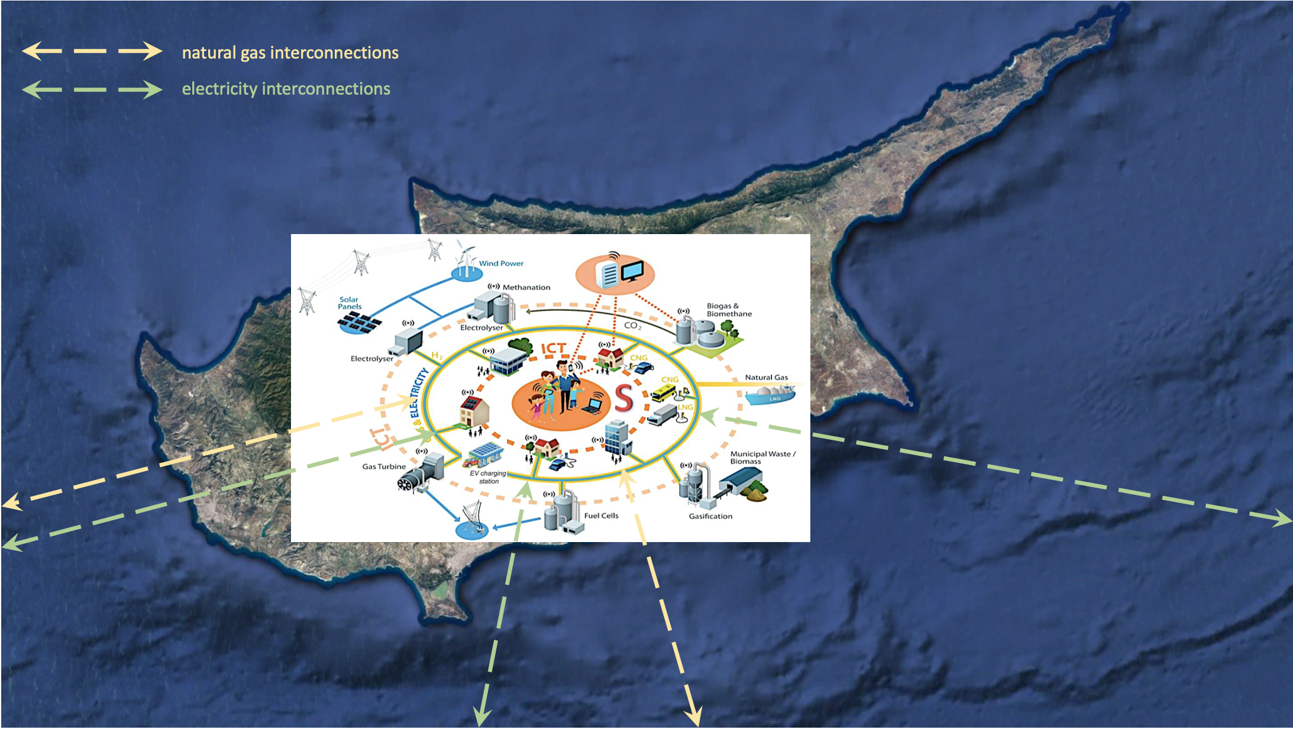
Energy transition by 2050*
Cyprus’ energy system:
smart and digitised
flexible
decentralised
electrically interconnected
interconnected gas and/or
hydrogen pipelines
Integration:
hydrogen in all energy sectors
renewable energy sources
storage energy systems
electric mobility
Transition of Cyprus from the current carbon economy to hydrogen economy by the year 2050
* Poullikkas A., 2020, Long-term Sustainable Energy Strategy: Cyprus’ Energy Transition to Hydrogen Economy,
ISBN: 978-9925-7710-0-4

